Slide 1
Chapter -2
Units
&
Measurements
Made by:-
Meenal Jindal
Air force school Ambala Cantt

Slide 2
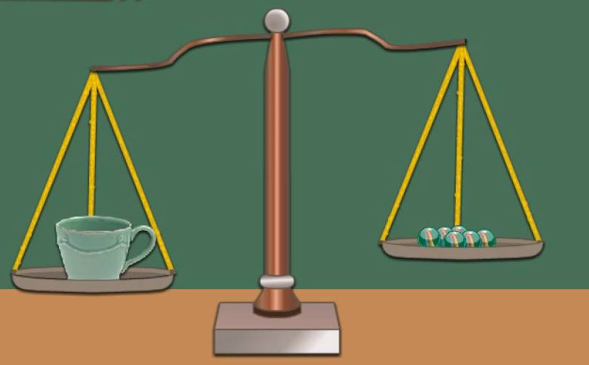
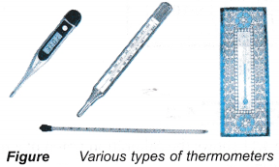
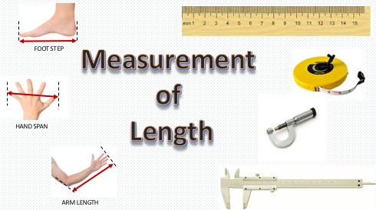
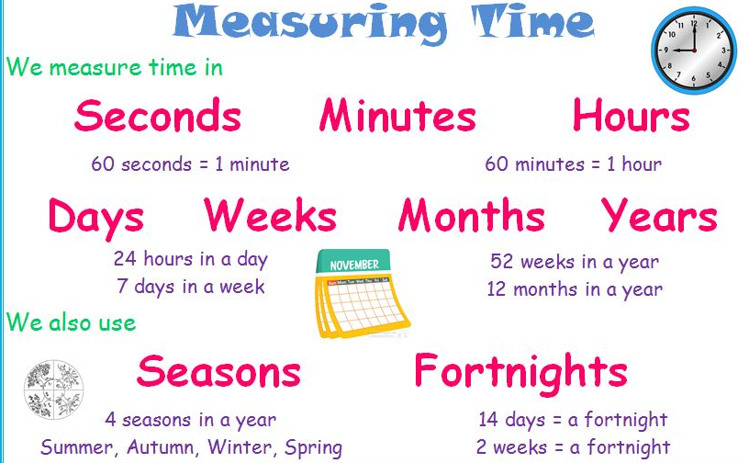
Measurement
In everyday life we encounter with different physical quantities like mass, length, time, temperature etc for which we have to do measurements.
Measurement of mass Measurement of temperature

Slide 3
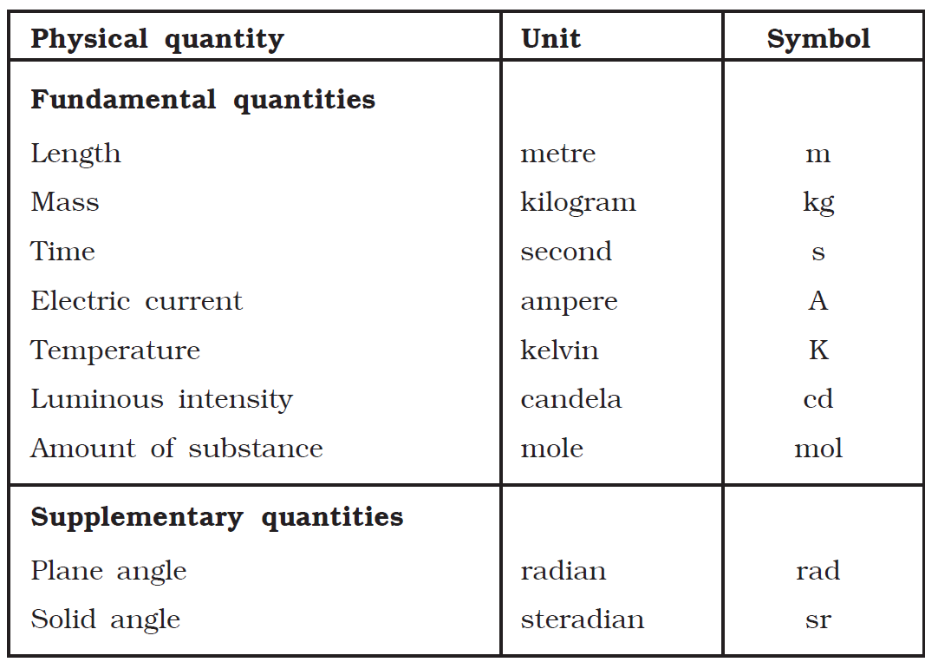

Slide 4
Need for measurement in physics
For proper study of any physical phenomena it is essential to do experiments & for that various physical quantities involved like temperature, mass, length, time etc has to be measured accurately & precisely so that various laws & principles related to that phenomena will be experimentally verified.
Physical quantity:- A physical property that can be measured & described by a number is called physical quantity. For example mass of a body is 40 kg, length of box is 5 metre, temperature of room is 300 kelvin, area of room is 400 m² .
There are basically two types of physical quantities:
Fundamental quantity:- The quantity which do not depend on any other physical quantity for their measurement. For example mass, length, time etc
Derived quantity:- the quantity which depend on one or more fundamental quantity for their measurement. For example area, volume, density etc

Slide 5
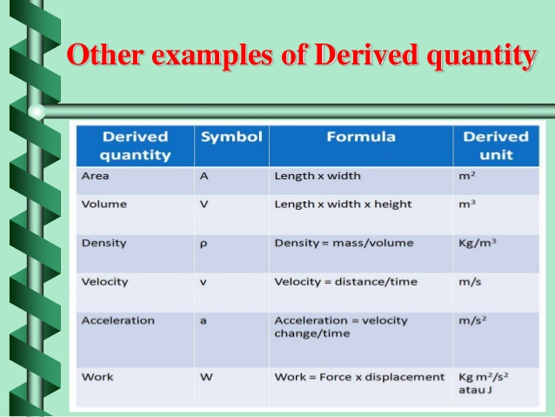

Slide 6
To measure any physical quantity a standard is required & that standard is called as unit.
Examples of unit are
metre, foot & inch are units of mass
fahrenheit, celsius & kelvin are units of temperature
kilogram, pound are units of mass
second, minute & hour are units of time
Characteristics of standard unit
Well defined
Internationally accepted
Easily accessible
Proper size
Easily reproducible
Indestructible

Slide 7
System of units
There are basically four system of units:-
CGS system:- First introduced in France. Also known as Gaussian system. Based on centimeter, gram & second as fundamental unit of length, mass & time.
FPS system:- First introduced in Britain. Also known as British system of units. Based on foot, pound & second as fundamental unit of length, mass & time.
MKS system:- First introduced in France. Also known as French system of units. Based on metre, kilogram & second as fundamental unit of length, mass & time.
International system of units (SI system):- A new system of units was internationally adopted in Eleventh general conference of weights & measures in 1960. in SI unit system there are seven fundamental units & two supplementary units.

Slide 8
Definitions of basic & supplementary units
Metre (m):- it is the length of path travelled by light in vacuum in 1/299,792458 of a second.
Kilogram (kg):- it is the mass of a platinum- iridium cylinder having its diameter equal to height preserved at international bureau of weights & measures.
Second (s):- it is the time taken by cesium-133 atom to make 9,192,631,770.0 vibrations.
Ampere (A):-it is that constant current which when flows through each of two long straight parallel conductors of infinite length & negligible area of cross-section placed at one metre apart in vacuum experiences a force of 2 × 10⁻⁷ N/m between them.
Kelvin (K):-it is defined as (1/273.16)th of the thermodynamic of triple point of water.
Candela (cd):- it is defined as luminous intensity in a direction right angle to a surface of 1/600000 square metre area of a black body, at a temperature of freezing platinum under a pressure of 101325 newton per metre square.

Slide 9
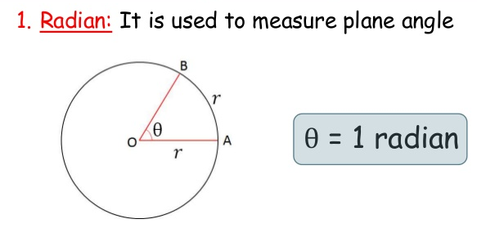
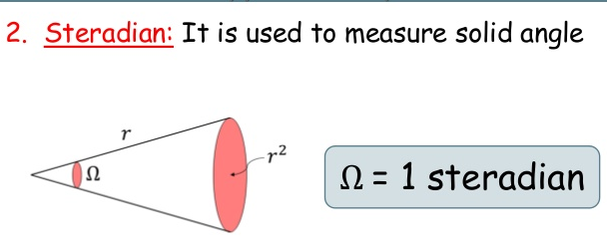
Mole (mol):- it is the amount of substance that contains as many elementary units as there are atoms in exactly 0.12kg of pure carbon -12.
Supplementary units
Radian(rad):- it is the measure of angle subtended at centre of circle by an arc having length equal to radius of circle.
Steradian (Sr):- it is the angle subtended at centre of a sphere by its surface whose area is equal to square of radius of sphere.

Slide 10
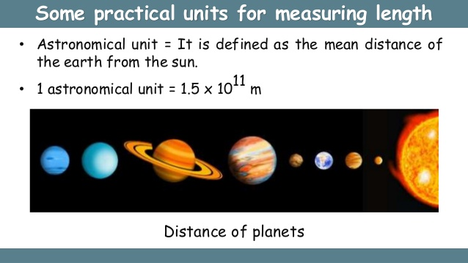
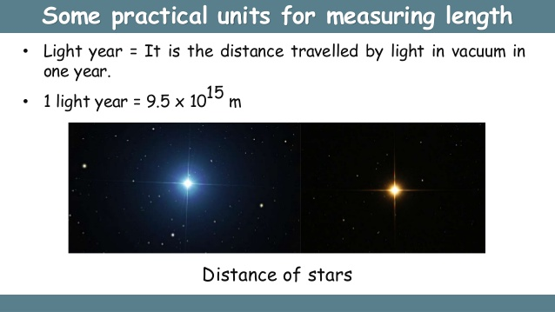
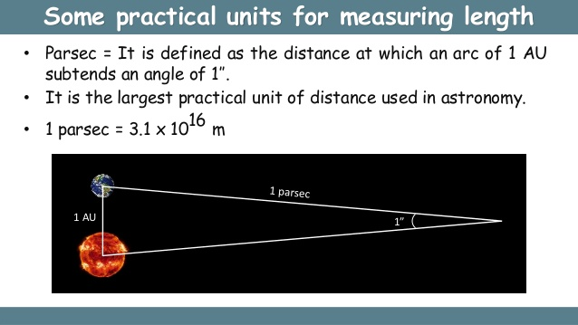

Slide 11
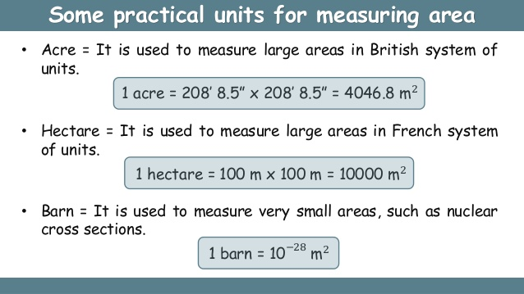
Smaller units to measure length are
1 Angstorm(Å)= 10⁻¹⁰m 1 nanometer(nm)= 10⁻¹⁵m
1 Micron=10⁻⁶m

Slide 12
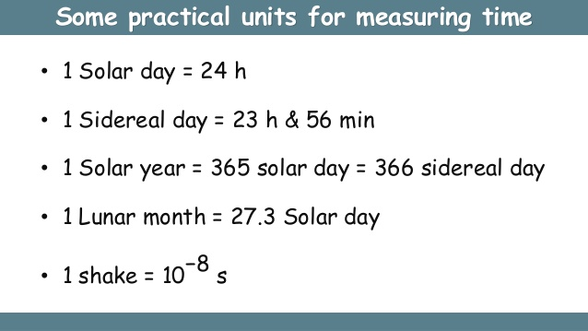

Slide 13
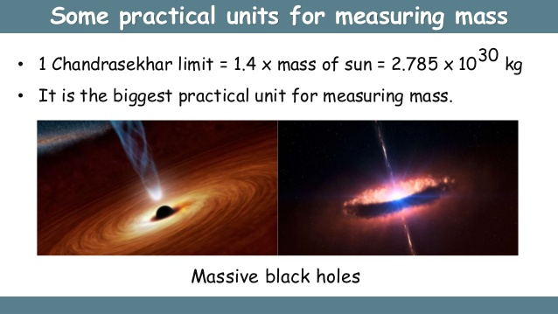
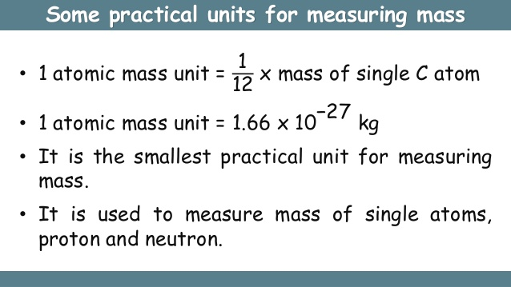

Slide 14
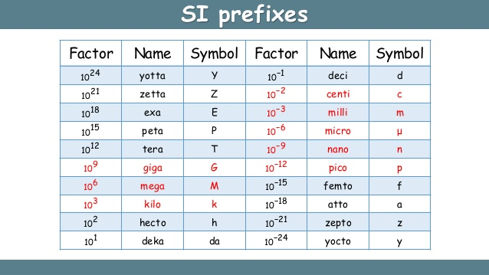
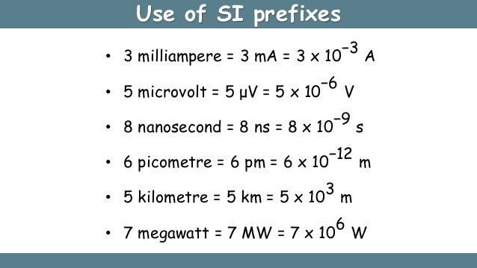

Slide 15
Measurement of length & distances
Direct methods:- Metre scale, Vernier calliper, Screw gauge are different direct methods to measure length of object.
Indirect or Approximation methods:- Echo method, parallax method, Laser method, Radar method
Measurement of mass & weight
Physical balance, Inertial balance, spring balance are some instruments to measure them.
Measurement of time interval
Sun dial, Electronic clock, Atomic clock, Radioactive dating, Quartz clock, Pendulum clock are some devices to measure time accurately & precisely.

Slide 16
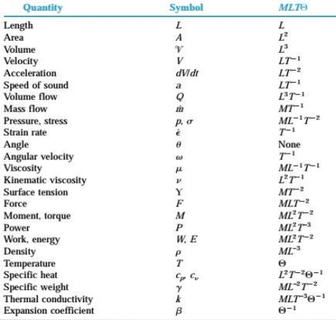
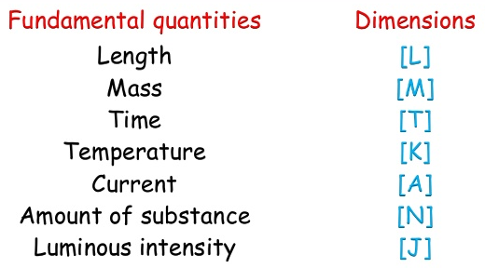
Dimension & dimensional analysis
It is a physical property which describes a way any physical quantity is relate to fundamental physical quantities.
Dimensional analysis is the analysis of relationships between different physical quantities by identifying their fundamental dimensions such as length, mass & time.

Slide 17
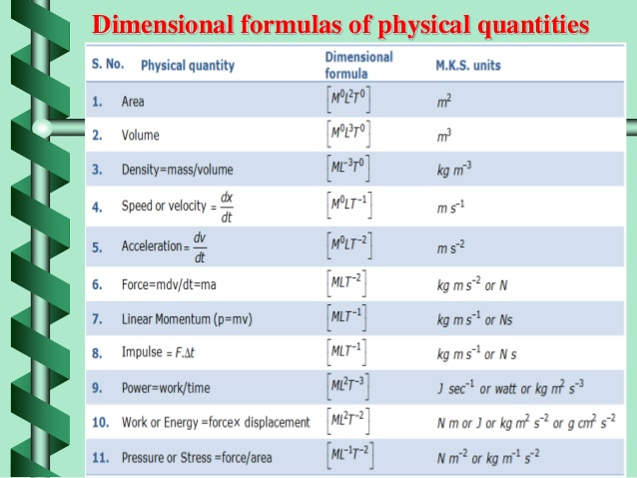

Slide 18
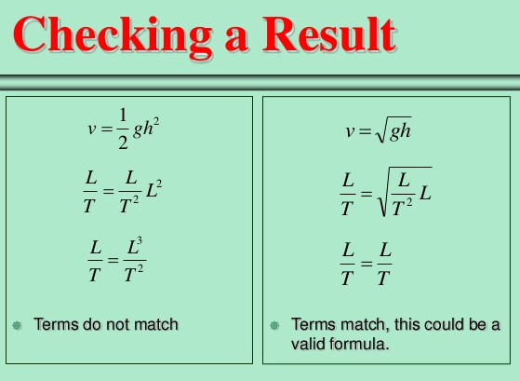
Principle of Homogeneity:- The equation is dimensionally correct if dimensions on left side of equation are equal to dimension on right side of equation, if not the equation is not dimensionally correct.

Slide 19
Types of Variables & constants
Dimensional Variables:- Physical quantities which possess dimensions & have variable values. Examples are Force, velocity, momentum etc.
Dimensional Constants:- Physical quantities which possess dimensions & have constant values. Examples are Gravitational constant, Planck’s constant etc.
Dimensionless Variables:- Physical quantities which possess no dimensions but have variable values. Examples are angle, strain, specific gravity etc.
Dimensionless Constants:- Physical quantities which possess no dimensions but have constant values. Example are π, e,1,2,3 etc.

Slide 20
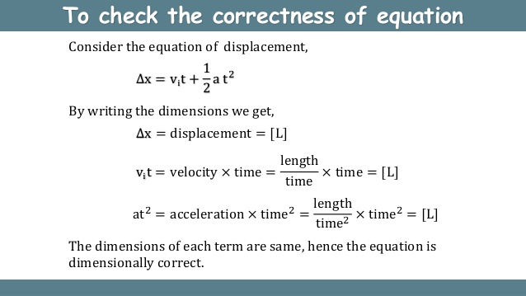
Uses of Dimensional analysis
To check the correctness of the formula

Slide 21
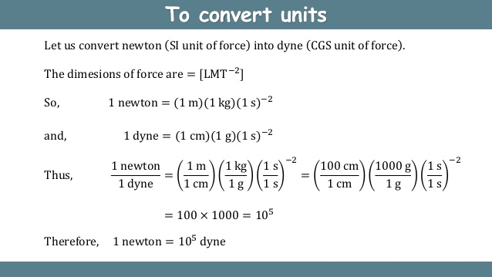
To convert one system of units into another system

Slide 22
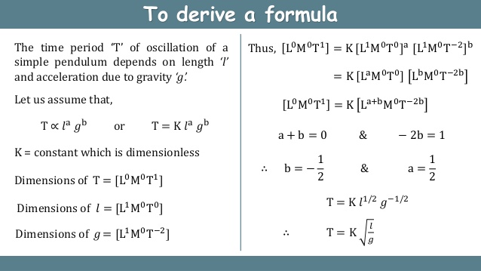
To derive a formula

Slide 23
Limitations of dimensional analysis
This method gives no information about dimensionless constants & pure numbers.
This method fails when a physical quantity depends on more than three physical quantities.
It gives no information whether a physical quantity is a scalar or vector quantity.
This method can not be used t derive relations involving trigonometrical, logarithmic, exponential functions.
This method fails to derive a relation which contains two or more variables having same dimensions.

Slide 24
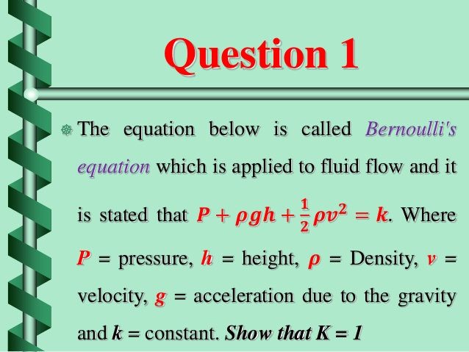
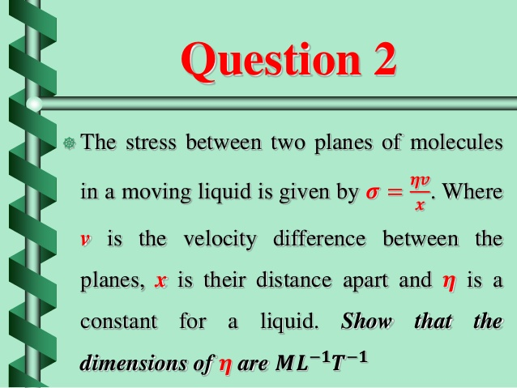
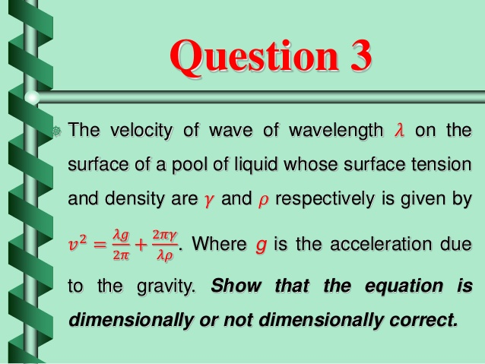
Questions for practice

Slide 25
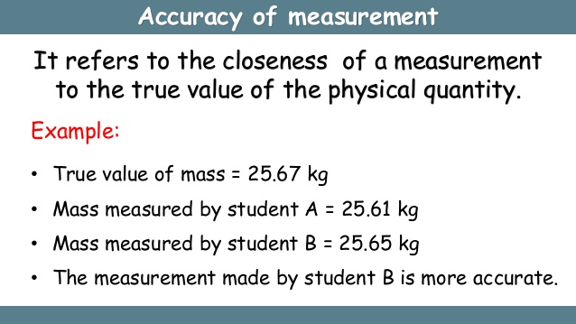
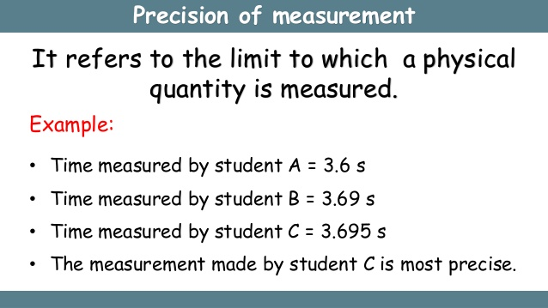
Least count of an instrument:- The smallest value that can be measured from a measuring instrument.

Slide 26
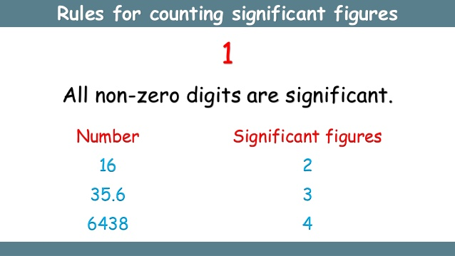
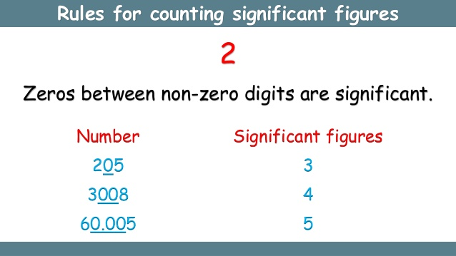
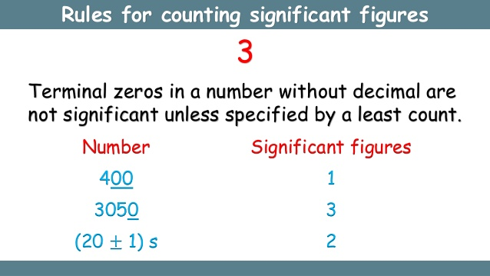
Significant figures:- The digits whose values are accurately known in a particular measurement. Larger is the number of significant figures in a measurement, higher is accuracy of measurement & vice- versa.

Slide 27
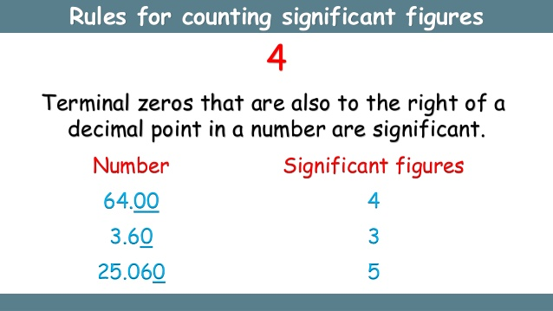
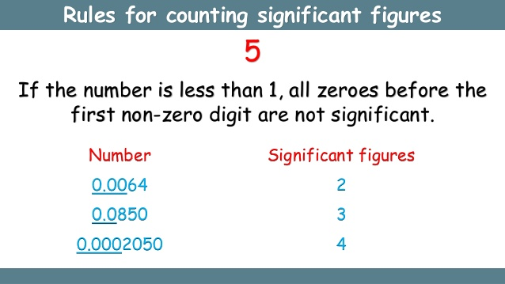
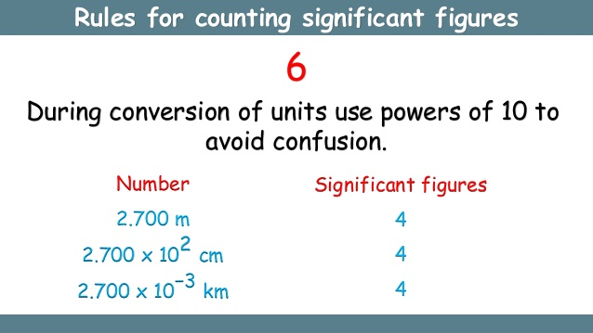

Slide 28
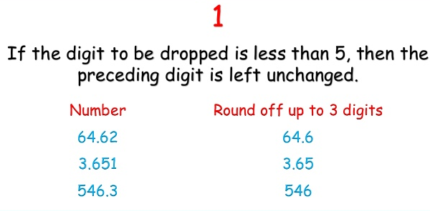
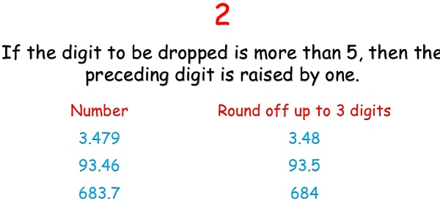
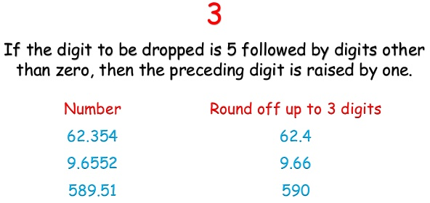
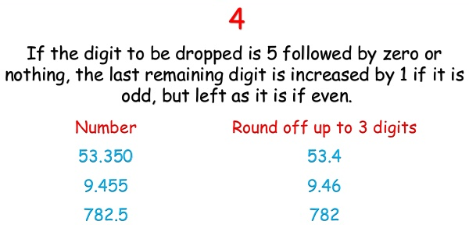
Rounding off & its rules
During calculation of result of experiment approximation is required & for that rounding off a number is done to get the final result. Rules for rounding off are as follows:-

Slide 29
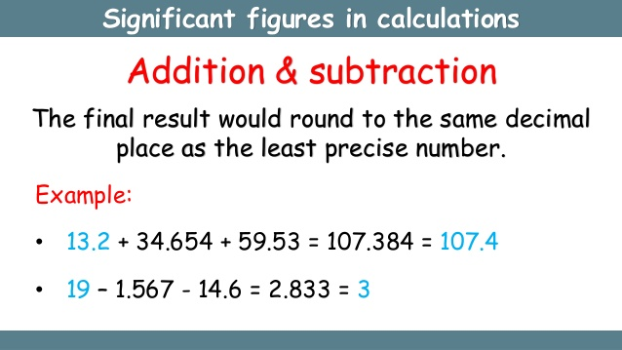
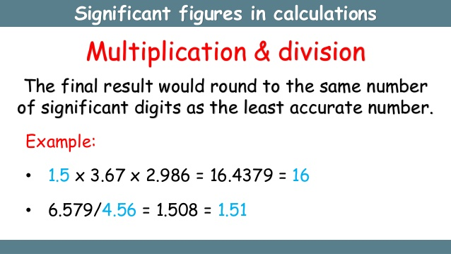
Arithmetic operations using significant figures

Slide 30
Errors in Measurements
Error in measurement is the difference between true/ actual value & measured value of physical quantity.
Error in quantity = | True value – Measured value |
Types of errors:- Following are the errors which are normally encountered while doing measurements.
Systematic Errors
Random errors
Gross Errors
Least count errors
Systematic Errors:- These errors occur according to some definite pattern. It can be reduced by knowing the exact cause of error as system involves observer, measuring instrument & environment. It is of following types:-

Slide 31
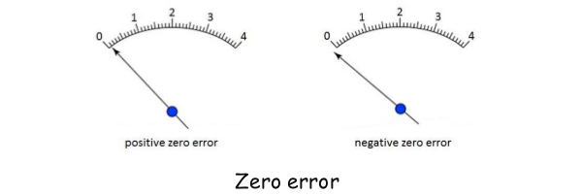
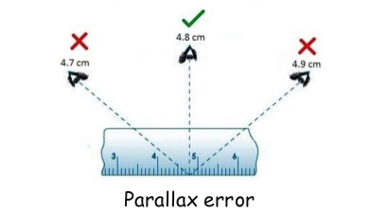
Instrumental Error:- it is caused due to inbuilt defect of the measuring instrument.
Personal Error:- It is error in measurement of physical quantities due to carelessness or limitations of observer. This can be reduced only if the observer does the experiment with its full concentration.
Environmental Error:- These are caused by external conditions like temperature, humidity, pressure etc. These can be removed when experiments are done under suitable &controlled conditions.

Slide 32
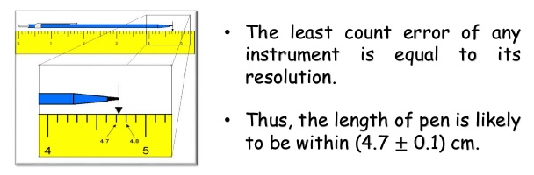
Random Error:- They are those errors which occur irregularly due to unpredictable changes in experimental conditions. They are also called as CHANCE ERRORS. They can be minimised but not eliminated & the error can be estimated by using some statistical operations.
Gross Error:- It is caused by mistakes in using instruments, recording data or calculating results. It can be reduced to great extent by careful reading & recording of data.
Least Count Error:- It is the error which is associated with the resolution of measuring instrument.

Slide 33
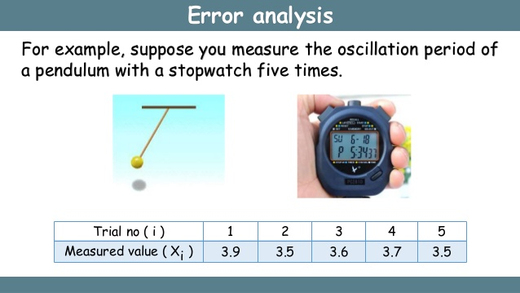
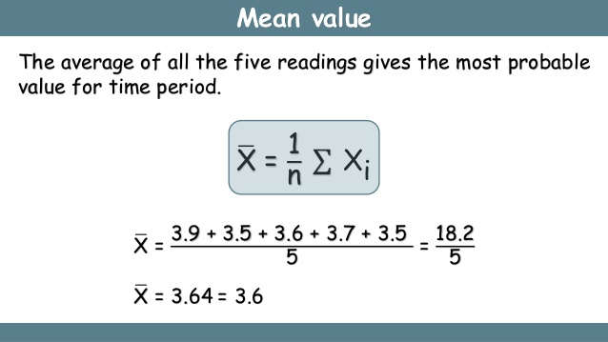
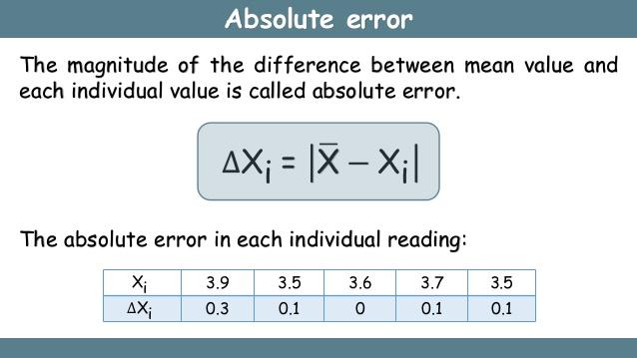
Elimination of Error:- It can be easily explained with the help of following example:-

Slide 34
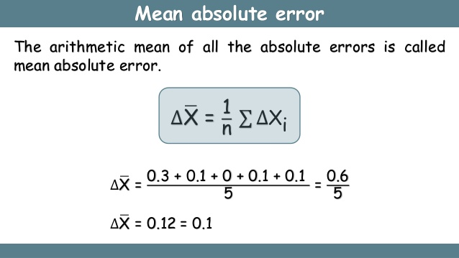
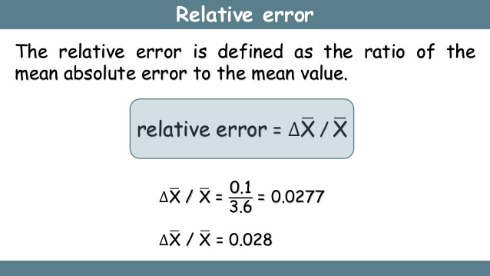
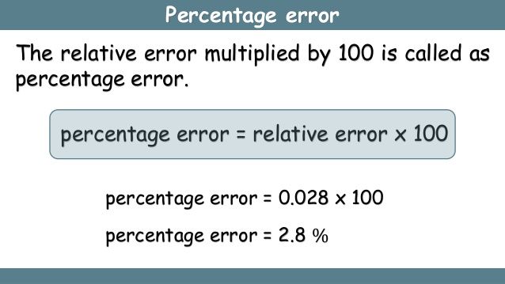

Slide 35


Combination of Error
When the final result involves sum or difference of two observed quantities of same type then error calculation formula is

Slide 36


When final result involves product or quotient of two observed physical quantities then error calculating formula is
When final result is equal to some power of physical quantity then error calculating formula is

Slide 37
REFERENCES
Ncert book chapter 1
Vedantu notes of chapter 1
www. Images.com
Slideshare.com
Dinesh publications

Slide 38


