Slide 1
Chapter 1
Physical world & Measurement
Presented by:-
Meenal Jindal
Air force school Ambala Cantt

Slide 2
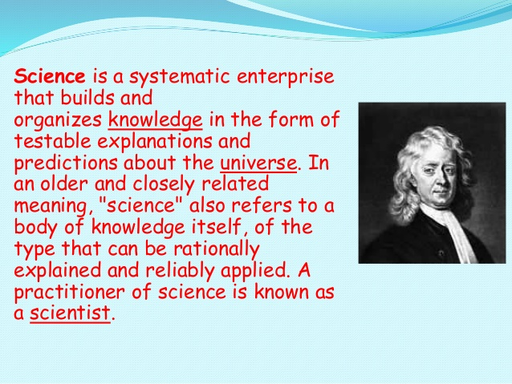
What is Science?

Slide 3
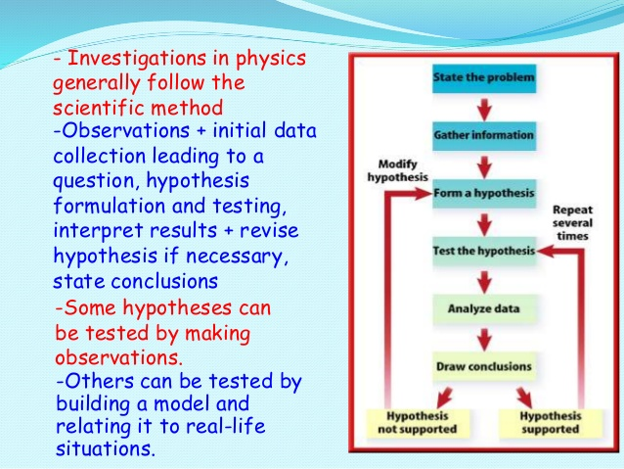
Scientific Attitude
&
Scientific Method

Slide 4
Branches of Science
Basically science is a subject which is concerned with description, prediction & understanding of natural phenomena based on observational evidence. It is basically consists of following disciplines:-
Chemistry
Biology
Physics

Slide 5
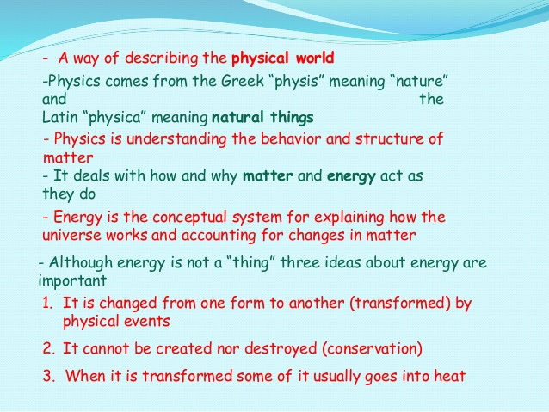
What is Physics?
There are basic two approaches in physics:-
Unification:- This approach means considers that all the world’s phenomena is a collection of laws in different domains & conditions.
Reduction:- This approach derives the properties of complex parts from the properties & interaction of its constituent

Slide 6
Impact & uses of physics
It can explain any larger magnitude phenomena with the help of a simple theory.
Various devices had been developed using laws of physics
Experiments & observations are used to develop new theories & existing theories can also be modified accordingly.

Slide 7
Scope of Physics
It is very vast as it cover quantities with length magnitude as high as 10⁴⁰m or more ( i.e. astronomical studies of universe) and as low as 10⁻¹⁴m or less (i.e. study of electrons, protons etc). Similarly the range of time scale is from 10⁻²²s to 10¹⁸s and mass from 10⁻³⁰kg to 10⁵⁵kg.
Physics is broadly divided into two types based on its scope - Classical Physics and Modern Physics. Classical physics deal with the macroscopic phenomena while the modern physics deals with the microscopic phenomena.

Slide 8
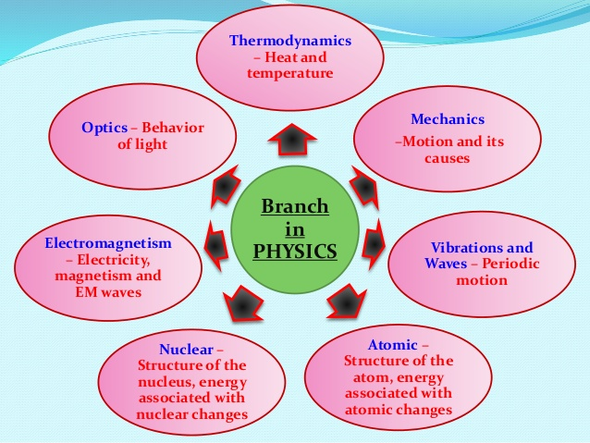

Slide 9
Factors responsible for progress of physics
Extracting & focusing on essential features of an phenomena
Application of universal laws in different contexts
Quantitative analysis with qualitative analysis
Approximation approach which includes breaking of complex parts into the collection of basic laws

Slide 10
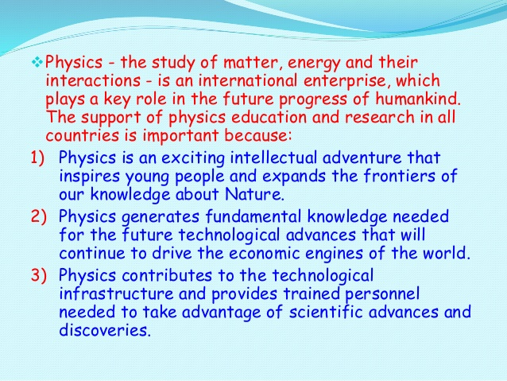
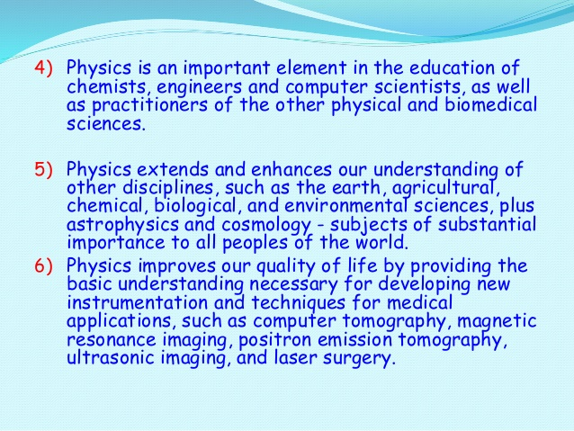
Physics in relation with
Technology & Society

Slide 11
Technological applications
Several examples are there where concepts of physics had led to important discoveries or inventions. Some of them are:-
Steam engine from concepts of thermodynamics
Wireless communication after discovery of laws of electricity & magnetism
Conversion of solar, wind & geothermal energies into electricity.
Neutron induced fission has led to development of nuclear reactors.

Slide 12
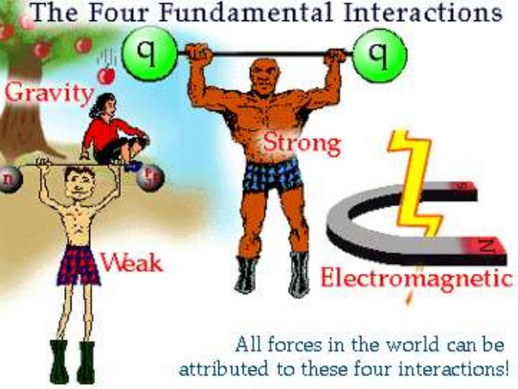
Fundamental Forces in nature

Slide 13
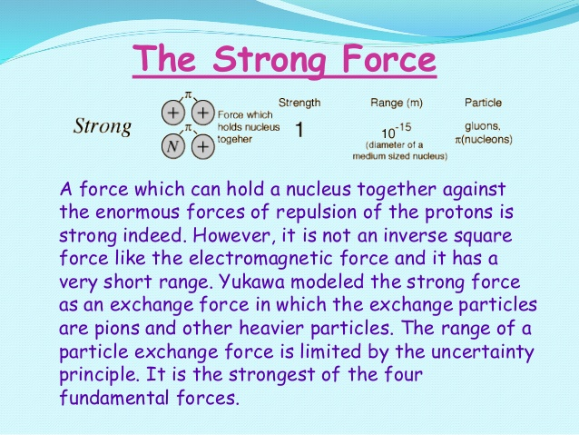
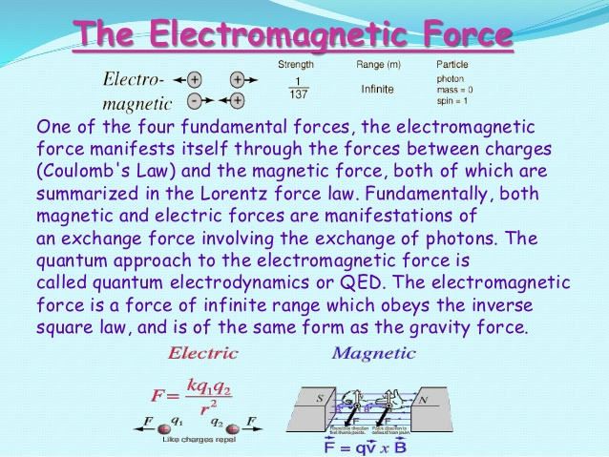

Slide 14
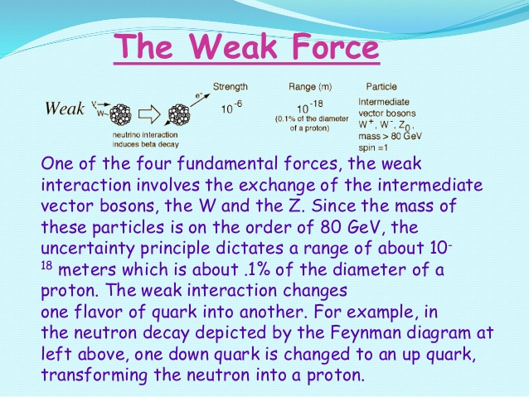
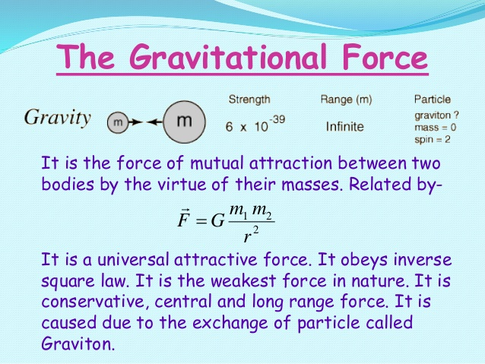
v

Slide 15
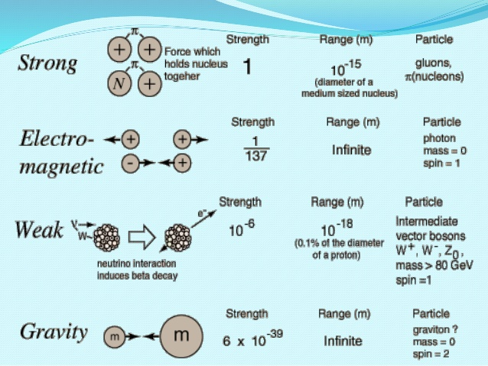
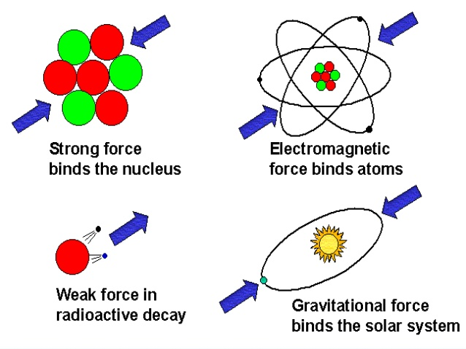

Slide 16
Unification of Forces: There have been physicists who have tried to combine a few of the above fundamental forces. These are listed in table below.
Name of Physicist Year Achievement in Unification
Isaac Newton 1687 Unified celestial and terrestrial mechanics.
Hans Christian Oersted
and Michael Faraday 1820 and 1830 respectively Unified electric and magnetic phenomena to give rise to electromagnetism.
James Clerk Maxwell 1873 Unified electricity, magnetism and optics to show that light is an electromagnetic wave.
Sheldon Glashow, Abdus
Salam, Steven Weinberg 1979 Gave the idea of electro-weak force which is a combination of electromagnetic and weak nuclear force. Salam, Steven Weinberg
Carlo Rubia, Simon Vander Meer 1984 Verified the theory of elctro-weak force.

Slide 17
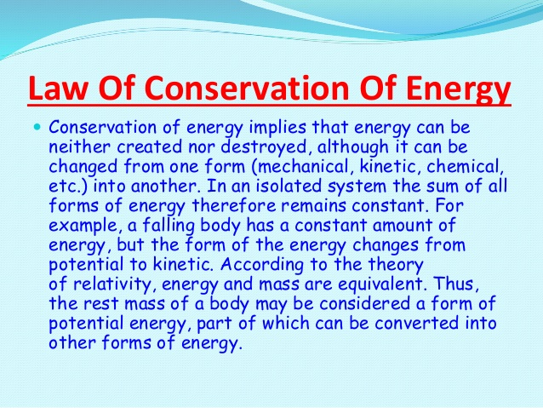
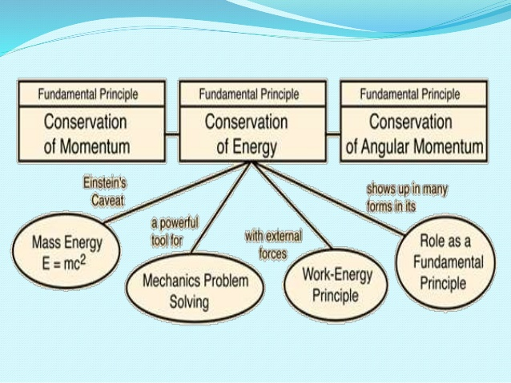
Conservation Laws

Slide 18
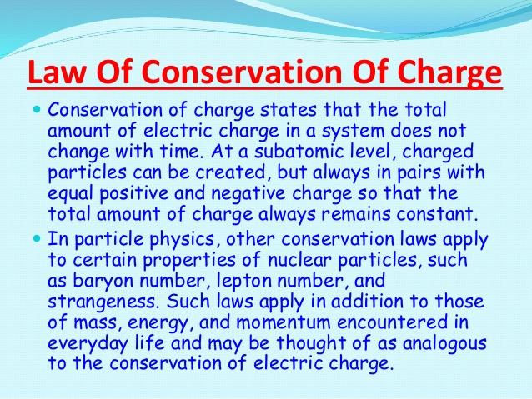

Slide 19
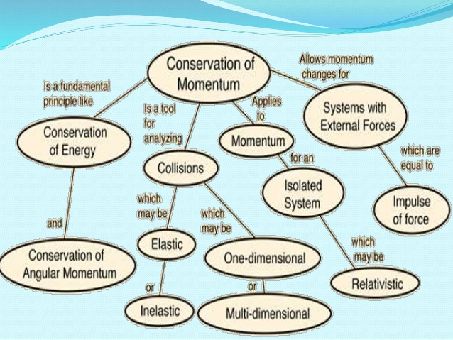
Law of Conservation of Linear Momentum
It states that in an “Isolated system if no external forces are there, then the momentum will remain conserved”.

Slide 20
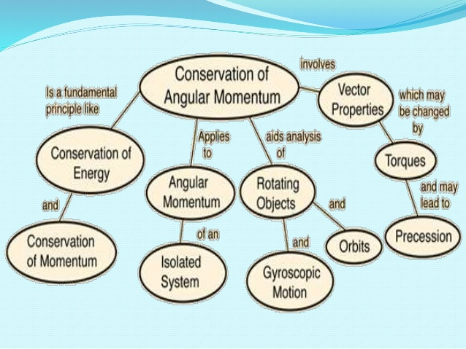
Law of Conservation of Angular Momentum
It states that in an “Isolated system in the absence of external torque the total angular momentum of a body will remain conserved”. It is rotational analogue form of conservation of linear momentum.

Slide 21
references
Ncert book chapter 1
Vedantu notes of chapter 1
www. Images.com
Slideshare.com

Slide 22


