Slide 1
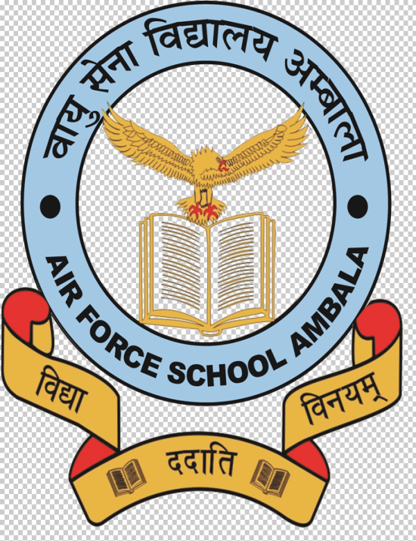
Theme: 2
Writing and City Life
XI –History(027)
Session:2020-2021
Prepared By
Anupam Handa
PGT-History
Air Force School, Ambala Cantt

Slide 2
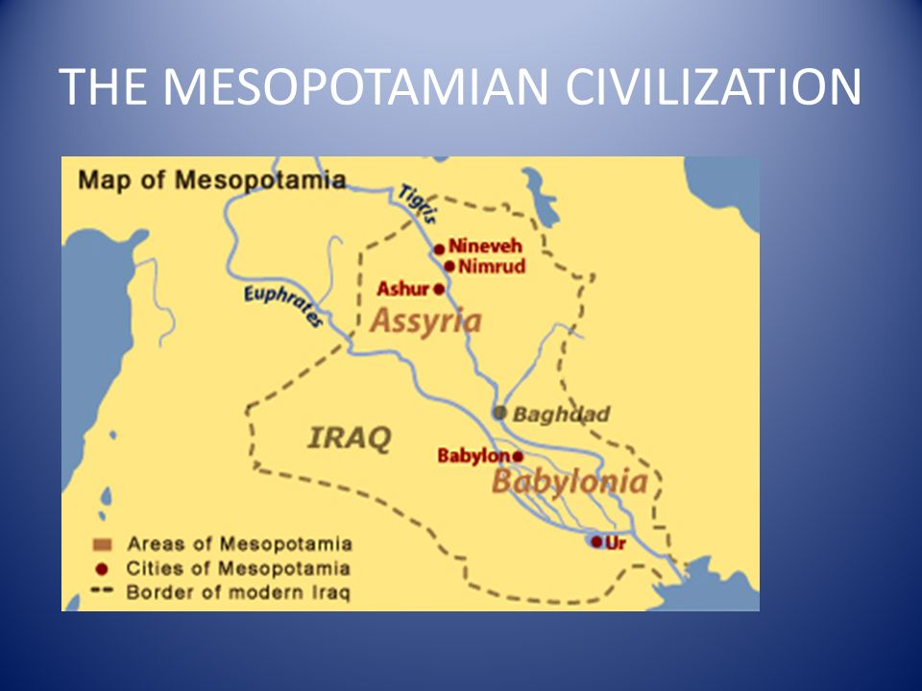
Source: https://www.google.com/search?q=pics+of+mesopotamian+civilization&client=firefox-b-d&sxsrf=ALeKk02GSqpU9KclUZppUofhba8-qt6anA:1594204340926&source=lnms&tbm=isch&sa=X&ved=2ahUKEwjhwcL7ub3qAhXawTgGHeP2CtAQ_AUoAXoECA0QAw#imgrc=Wno1bu9bE-OSrM

Slide 3
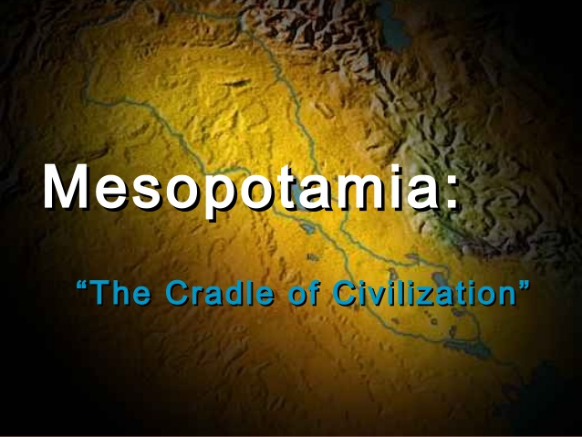

Slide 4
Introduction of Mesopotamia
City life began in Mesopotamia, the land between the Euphrates and the Tigris rivers that is now part of the Republic of Iraq. Mesopotamian civilization is known for its prosperity, city life, its voluminous and rich literature and its mathematics and astronomy.
The name Mesopotamia is derived from the Greek words mesos, meaning middle, and potamos, meaning river.
The first known language of the land was Sumerian. This language flourished till about Alexander’s time (336-323 BCE), with some regional changes occurring. From 1400 BCE,

Slide 5
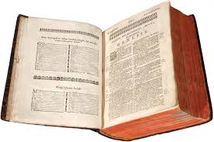
Interesting Facts
Mesopotamia was important to Europeans because of references to it in the Old Testament, the first part of the Bible. For instance, the Book of Genesis of the Old Testament refers to ‘Shimar’, meaning Sumer, as a land of brick-built cities. Travellers and scholars of Europe looked on Mesopotamia as a kind of ancestral land, and when archaeological work began in the area, there was an attempt to prove the literal truth of the Old Testament.
Source: www.ncert.nic.in

Slide 6
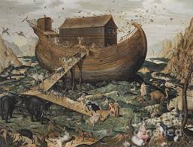
According to the Bible, the Flood was meant to destroy all life on earth. However, God chose a man, Noah, to ensure that life could continue after the Flood. Noah built a huge boat, an ark. He took a pair each of all known species of animals and birds on board the ark, which survived the Flood. There was a strikingly similar story in the Mesopotamian tradition, where the principal character was called Ziusudra or Utnapishtim.

Slide 7
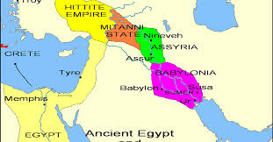
Mesopotamia and its Geography
Iraq is a land of diverse environments. In the north-east lie green, undulating plains, gradually rising to tree-covered mountain ranges with clear streams and wild flowers, with enough rainfall to grow crops.
Here, agriculture began between 7000 and 6000 BCE. In the north, there is a stretch of upland called a steppe

Slide 8
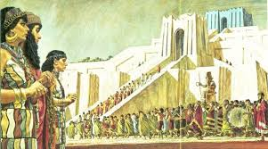
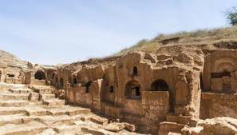

Slide 9
To the East, tributaries of the Tigris provide routes of communication into the mountains of Iran. The south is a desert – and this is where the first cities and writing emerged .This desert could support cities because the rivers Euphrates and Tigris, which rise in the northern mountains, carry loads of silt (fine mud). When they flood or when their water is let out on to the fields, fertile silt is deposited.

Slide 10
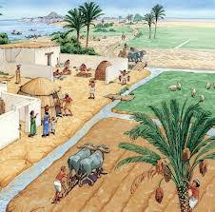
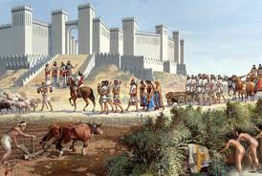
Significance of Urbanism

Slide 11
Features
Urban economies comprise besides food production, trade, manufactures and services. City people, thus, cease to be self-sufficient and depend on the products or services of other (city or village) people. There is continuous interaction among them.
The division of labour is a mark of urban life. Fuel, metal, various stones, wood, etc., come from many different places for city manufacturers. Thus, organized trade and storage is needed.
There are deliveries of grain and other food items from the village to the city, and food supplies need to be stored and distributed.

Slide 12
ACTIVITY
Discuss whether city life would have been possible without the use of metals.

Slide 13
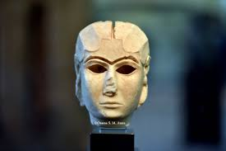
Image of Warka Head

Slide 14
FEATURES :WARKA HEAD
This woman’s head was sculpted in white marble at Uruk before 3000 BCE.
The eyes and eyebrows would probably have taken lapis lazuli (blue) and shell (white) and bitumen (black) inlays, respectively.
There is a groove along the top of the head, perhaps for an ornament.
This is a world-famous piece of sculpture, admired for the delicate modeling of the woman’s mouth, chin and cheeks. And
it was modeled in a hard stone that would have been imported from a distance.
Source: ncert.nic.in

Slide 15
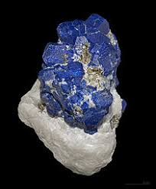
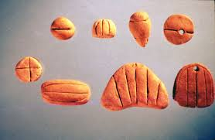
Movement of Goods into Cities
The ancient Mesopotamians could have traded their abundant textiles and agricultural produce for wood, copper, tin, silver, gold, shell and various stones from Turkey and Iran, or across the Gulf.

Slide 16
The cheapest mode of transportation is, everywhere, over water. River boats or barges loaded with sacks of grain are propelled by the current of the river and/or wind, but when animals transport goods, they need to be fed.
The canals and natural channels of ancient Mesopotamia were in fact routes of goods transport between large and small settlements, and in the account on the city of Mari later in the chapter, the importance of the Euphrates as a ‘world route’ will become clear.

Slide 17
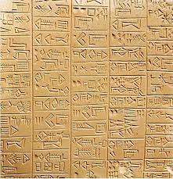
Development of Writing
The first Mesopotamian tablets, written around 3200 BCE, contained picture-like signs and numbers. These were about 5,000 lists of oxen, fish, bread loaves, etc. – lists of goods that were brought into or distributed from the temples of Uruk, a city in the south.

Slide 18
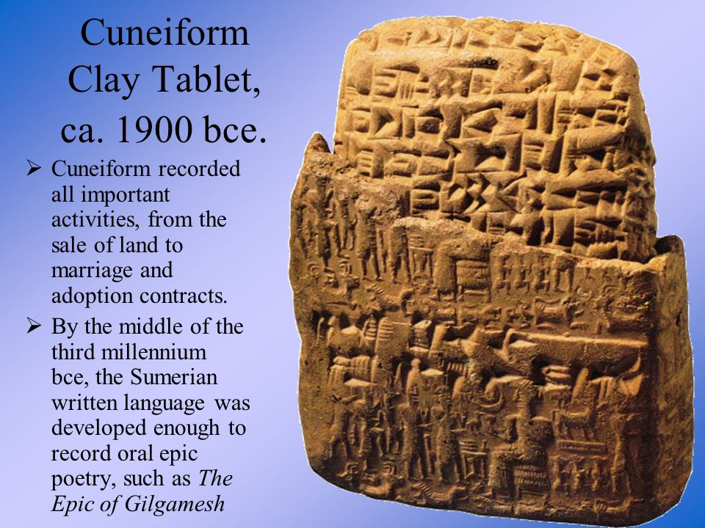

Slide 19
How it made?
Mesopotamians wrote on tablets of clay. A scribe would wet clay and pat it into a size he could hold comfortably in one hand. He would carefully smoothen its surfaces. With the sharp end of a reed cut obliquely, he would press wedge-shaped (‘cuneiform*’) signs on to the smoothened surface while it was still moist. Once dried in the sun, the clay would harden and tablets would be almost as indestructible as pottery.

Slide 20
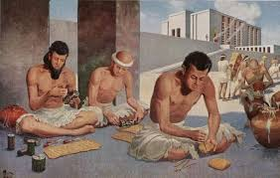
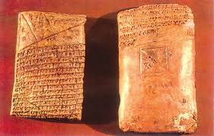

Slide 21
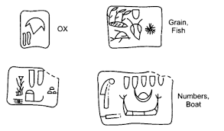
What is Cuneiform?
Cuneiform is derived from the Latin words cuneus,
meaning ‘wedge’ and forma, meaning ‘shape’.

Slide 22
By 2600 BCE or so, the letters became cuneiform, and the language was Sumerian. Writing was now used not only for keeping records, but also for making dictionaries, giving legal validity to land transfers, narrating the deeds of kings, and announcing the changes a king had made in the customary laws of the land. Sumerian, the earliest known language of Mesopotamia, was gradually replaced after 2400 BCE by the Akkadian language. Cuneiform writing in the Akkadian language continued in use until the first century CE, that is, for more than 2,000 years.
.

Slide 23
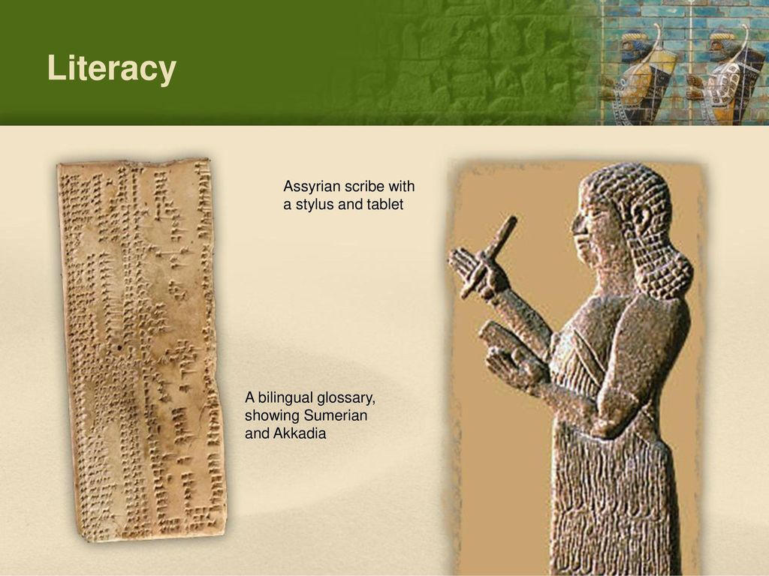
Literacy in Mesopotamia
Very few Mesopotamians could read and write. Not only were there hundreds of signs to learn, many of these were complex. If a king could read, he made sure that this was recorded in one of his boastful inscriptions! For the most part, however, writing reflected the mode of speaking.

Slide 24
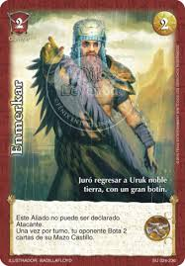
The Uses of Writing
The connection between city life, trade and writing is brought out in a long Sumerian epic poem about Enmerkar, one of the earliest rulers of Uruk. In Mesopotamian tradition, Uruk was the city par excellence, often known simply as The City.
Source: https://myl.fandom.com/es/wiki/Enmerkar

Slide 25
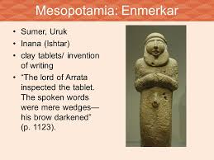

Slide 26
Enmerkar wanted lapis lazuli and precious metals for the beautification of a city temple and sent his messenger out to get them from the chief of a very distant land called Aratta. ‘The messenger heeded the word of the king. The messenger could not get the chief of Aratta to part with lapis lazuli or silver, and he had to make the long journey back and forth, again and again, carrying threats and promises from the king of Uruk.

Slide 27
Ultimately, the messenger ‘grew weary of mouth’. He got all the messages mixed up. Then, ‘Enmerkar formed a clay tablet in his hand, and he wrote the words down. In those days, there had been no writing down of words on clay. This poem also tells us that, besides being a means of storing information and of sending messages afar, writing was seen as a sign of the superiority of Mesopotamian urban culture

Slide 28
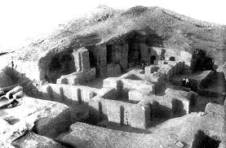
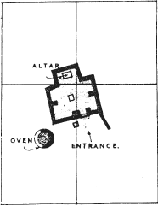
Urbanisation in Southern Mesopotamia
Source: market.edugorilla.com

Slide 29
Urbanisation in Southern Mesopotamia:
Temples and Kings
The earliest known temple was a small shrine made of unbaked bricks.
Temples were the residences of various gods: of the Moon God of Ur, or of Inanna the Goddess of Love and War.
Constructed in brick, temples became larger over time, with several rooms around open courtyards.
The god was the focus of worship: to him or her people brought grain, curd and fish (the floors of some early temples had thick layers of fish bones).

Slide 30
Man-Made Problems
Those who lived on the upstream stretches of a channel could divert so much water into their fields that villages downstream were left without water. Or they could neglect to clean out the silt from their stretch of the channel, blocking the flow of water further down. So the early Mesopotamian countryside saw repeated conflict over land and water.
When there was continuous warfare in a region, those chiefs who had been successful in war could oblige their followers by distributing the loot, and could take prisoners from the defeated groups to employ as their guards or servants.

Slide 31
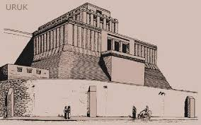
Uruk City
Uruk, one of the earliest temple towns. Archaeological surveys have shown that around 3000 BCE, when Uruk grew to the enormous extent of 250 hectares – twice as large as Mohenjo-Daro would be in later centuries – dozens of small villages were deserted.

Slide 32
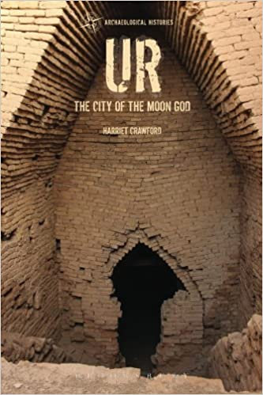
Ur an Earliest City
Ur was a town whose ordinary houses were systematically excavated in the 1930s.
Narrow winding streets indicate that wheeled carts could not have reached many of the houses.
Sacks of grain and firewood would have arrived on donkey-back.
Narrow winding streets and the irregular shapes of house plots also indicate an absence of town planning.

Slide 33
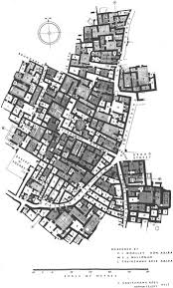
There were no street drains of the kind we find in contemporary Mohenjo-daro. Drains and clay pipes were instead found in the inner courtyards of the Ur houses and it is thought that house roofs sloped inwards and rainwater was channeled via the drainpipes into sumps in the inner courtyards.
This would have been a way of preventing the unpaved streets from becoming excessively slushy after a downpour.

Slide 34
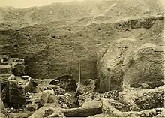
There was a town cemetery at Ur in which the graves of royalty and commoners have been found, but a few individuals were found buried under the floors of ordinary houses. A sump is a covered basin in the ground into which water and sewage flow.
Light came into the rooms not from windows but from doorways opening into the courtyards: this would also have given families their privacy. There were superstitions about houses, recorded in omen tablets at Ur.
Source: Royal Cemetery at Ur - Wikipediaen.wikipedia.org

Slide 35
The Seal – An Urban Artefact
In Mesopotamia until the end of the first millennium BCE, cylindrical stone seals, pierced down the centre, were fitted with a stick and rolled over wet clay so that a continuous picture was created. They were carved by very skilled craftsmen, and sometimes carry writing: the name of the owner, his god, his official position, etc. A seal could be rolled on clay covering the string knot of a cloth package or the mouth of a pot, keeping the contents safe. When rolled on a letter written on a clay tablet, it became a mark of authenticity. So the seal was the mark of a city dweller’s role in public life.

Slide 36
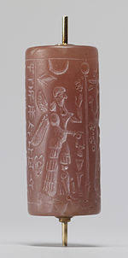
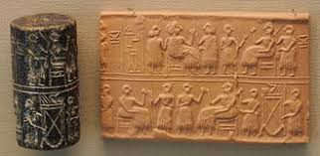
Images of Seals

Slide 37
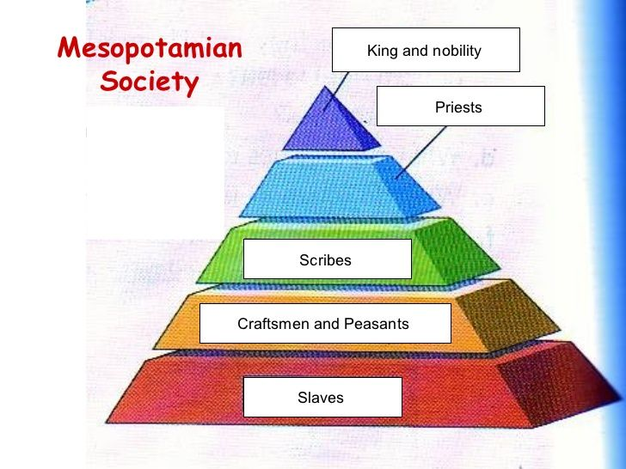
Society in Mesopotamia

Slide 38
Features of Society
A small section of society had a major share of the wealth. Nothing makes this fact as clear as the enormous riches (jewellery, gold vessels, wooden musical instruments inlaid with white shell and lapis lazuli, ceremonial daggers of gold, etc.) buried with some kings and queens at Ur.
But what of the ordinary people?
Ans: We know from the legal texts (disputes, inheritance matters, etc.) that in Mesopotamian society the nuclear family was the norm, although a married son and his family often resided with his parents.

Slide 39
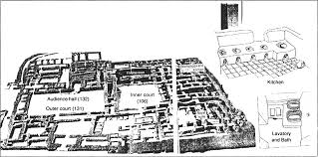
The Palace at Mari of King Zimrilim (1810-1760 BCE)

Slide 40
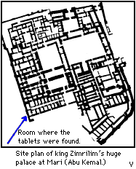
A great palace of Mari.
Residence of the royal family, the hub of administration, and a place of production, especially of precious metal ornaments.
Daily lists reveal that huge quantities of food were presented each day for the king’s table: flour, bread, meat, fish, fruit, beer and wine.

Slide 41
The large, open courtyards such as 131 were beautifully paved.
The king would have received foreign dignitaries and his own people in 132, a room with wall paintings that would have awed the visitors.
The palace was a sprawling structure, with 260 rooms and covered an area of 2.4 hectares.
It was so famous in its time that a minor king came
from north Syria just to see it, carrying with him a letter of introduction from a royal friend of the king of Mari, Zimrilim.

Slide 42
The Legacy of Mesopotamia
Perhaps the greatest legacy of Mesopotamia to the world is its scholarly tradition of time reckoning and mathematics.
Dating around 1800 BCE are tablets with multiplication and division tables, square- and square-root tables, and tables of compound interest.
The square root of 2 was given as:
1 + 24/60 + 51/602 + 10/603

Slide 43
The division of the year into 12 months according to the revolution of the moon around the earth, the division of the month into four weeks, the day into 24 hours, and the hour into 60 minutes – all that we take for granted in our daily lives – has come to us from the Mesopotamians.
These time divisions were adopted by the successors of Alexander and from there transmitted to the Roman world, then to the world of Islam, and then to medieval Europe .

Slide 44


Slide 45
1.Do you agree with the view that city life would have been impossible without the use of metal?
2. Explain why a system of writing is essential for the birth of a civilization?
3. Explain these terms:
Millennium
Modern Iraq
Lapis Lazuli
Sump

Slide 46


