Slide 1
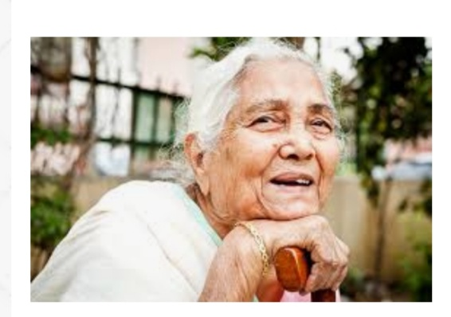
The Portrait of a Lady
Author - Khushwant Singh

Slide 2
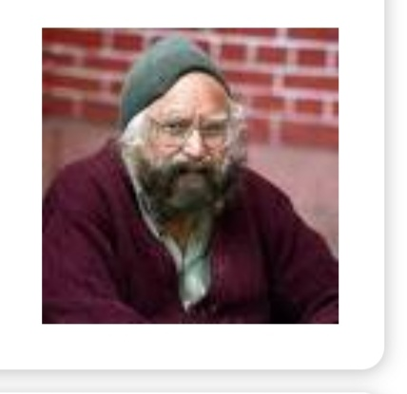
About the Author
Khushwant Singh - a famous Indian writer of English was born in 1915 and received his education in Lahore, Delhi and London. He was not only a novelist but also a reputed journalist.

Slide 3

Introduction
'The Portrait of a Lady' provides a vivid account of the author's relationship with his grandmother and changes that come about in their relationship. It is a loving tribute from a grandson to his grandmother where he reminds about the emotional bond he shared with her. It forces the readers to evaluate their own relationships with their grandparents and to reflect on the reasons for the growing isolation of elders in families

Slide 4
Glossary
ABSURD: wildly unreasonable, illogical, or inappropriate.
FABLES: a short story, typically with animals as characters, conveying a moral.
WRINKLES: a slight line or fold in something, especially fabric or the skin of the face.
HOBBLED: walk in an awkward way, typically because of pain from an injury.
SCATTERED: throw in various random directions.
INAUDIBLE: unable to be heard.
GROWLING: (of a person) say something in a low harsh voice, typically in a threatening manner.
COURTYARD: an unroofed area that is completely or partially enclosed by walls or buildings, typically one forming part of a castle or large house.
SCRIPTURES: the sacred writings of Christianity contained in the Bible.
VERITABLE: used for emphasis, often to qualify a metaphor.
FRIVOLOUS: not having any serious purpose or value.
SAGGING: sink, subside, or bulge downwards under weight or pressure or through lack of strength.
DILAPIDATED: (of a building or object) in a state of disrepair or ruin as a result of age or neglect.
PALLOR: an unhealthy pale appearance.

Slide 5
MORAL
The story puts light on the need of companionship and friendship felt by our elders. It also shows how love and emotion is experienced not only by human beings but animals and birds too.

Slide 6

TITLE
The title of the chapter is apt. Besides being a pen sketch of his grandmother, the passage is Khushwant Singh's loving tribute to her, his relationship with her and the emotional bond he shared with her

Slide 7

Points to Remember
Author's reminiscence of his Grandparents
Early bonding with grandmother in village
Turning point in friendship
Common link of friendship snapped
Last days

Slide 8

IMPORTANT PHRASES

Slide 9
the thought was almost revolting – The thought that the author’s grandmother was once young and pretty raises a doubt in the mind of the author. He finds it too hard to believe.
an expanse of pure white serenity – It refers to the calm, peaceful and serene character and conduct of the author’s grandmother. She is compared to the peaceful winter landscape in the mountains.
a turning-point – It refers to the point where the author’s relationship with his grandmother changes drastically after they move to the city-house.

Slide 10
accepted her seclusion with resignation – This shows the author’s grandmother’s passive submission to her secluded life after she gradually loses touch with her grandson.
a veritable bedlam of chirruping – It refers to the noise, confusion and chaos caused by the chirruping of the sparrows that scattered and perched around the author’s grandmother.
frivolous rebukes – It refers to the casual and light-hearted rebukes of the grandmother to the sparrows.
the sagging skins of the dilapidated drum – It points to the shabby and deteriorated condition of the drum.

Slide 11

Expected Questions

Slide 12
Question
Mention the three phases of the author’s relationship with his grandmother before he left the country to study abroad.
ANSWER:
The three phases of the author’s relationship with his grandmother before he left the country to study abroad are given below.
The first phase was the period of the author’s early childhood. During this phase, he used to live with his grandmother in the village. The grandmother used to take care of him from waking him up and getting him ready to accompanying him to the school. Both shared a good friendship with each other.
The second phase was the time when the author and the grandmother moved to the city to live with author’s parents. This was a turning-point in their friendship because now they ‘saw less of each other’.
The third phase was the time the author joined University. He was given a room of his own and the common link of their friendship was snapped. The grandmother turns to wheel-spinning and reciting prayers all day long. She accepts her seclusion with silence

Slide 13
Q. What was the happiest moment of the day for the grandmother?
Answer:
The happiest moment of the day for the grandmother in the city was when she was feeding the sparrows. They perched on her legs, shoulders, and head but she never shooed them away.
Q. What was ‘the last sign’ of physical contact between the author and the ? Why did author think that to be the last physical contact?
Answer:
The author was going abroad for five years. His grandmother kissed his forehead. He presumed this as the last sign of physical contact between them. He feared that she would not survive till he returned since he was going away for five years.

Slide 14
Question
Mention three reasons why the author’s grandmother was disturbed when he started going to the city school.
ANSWER:
The author’s grandmother was unhappy after knowing that the things taught to him at school were related to western science and learning. Secondly, she did not believe such things that were taught at his new school. She was disturbed that there was no teaching about God and scriptures. Thirdly, she was unhappy with the idea of music lessons being given at school. She considered music suitable only for the people with low dignity. The disapproval of the grandmother was visible in her silence.

Slide 15
What was the turning point in their friendship?
The turning point in the narrator's and his grandmother's friendship came when the author was summoned to the city by his parents. In the village, he and his grandmother had been going together to the school . His grandmother was also able to help him with his studies. However, things were different in the city .

Slide 16
Short Answer Type Questions
Q. Describe the grandmother in your own words.
Ans. The grandmother was a deeply religious woman. She was also kind hearted. She was not pretty to look at, yet she was beautiful. She was graceful and dignified in her bearing. She had perfect control over her emotions. She used to feed the dogs and birds.
Q. How were the narrator and the grandmother good friends in the village?
Ans. Grandmother woke him up every morning and got him ready for school. She would bathe and dress him up. She gave him breakfast, got him his slate, ink-pot and accompanied him to school. While he learnt at school, grandmother used to read the scriptures in the temple. When the school was over, they would walk back home together and feed the village dogs on the way.

Slide 17
Q.Why was the author’s grandmother unhappy with the city education?
Ans. The grandmother did not like the teaching at English school in the city. She was sad that they did not teach anything about God and the religious scriptures. Nor was she interested in science. She hated music lessons given in the school.
Q.Why did the grandmother hate music?
Ans. Grandmother considered that music was indecent and was meant only for harlots and beggars. It was not meant for gentle folk or school children from respectable families.
Q.Draw a comparison between village school education and city school education.
Ans. In the city school English and Science were taught. Music was also one of the subjects. There was no teaching about God and scriptures. The village school was attached to a temple. The priest himself acted as the teacher and taught the children the alphabet and the prayer.

Slide 18

Made By -Ravinder Kaur, PGT English, Air Force School Ambala
Resources used - NCERT

Slide 19


