Slide 1




Slide 2

Freedom

Slide 3

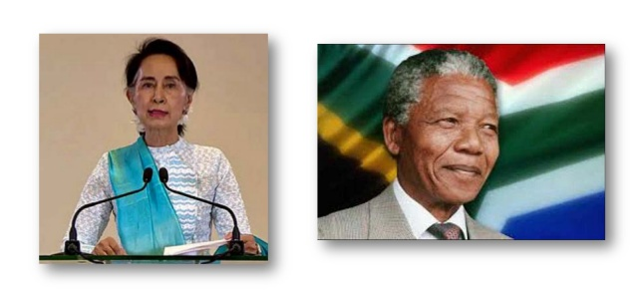

Slide 4
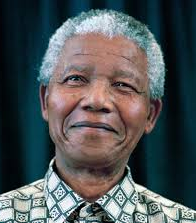
Nelson Mandela
"Long Walk to Freedom"
Personal Struggles against Apartheid.
Resistance to segregationist policies.
Humiliation, hardship and brutalities suffered by Blacks.
28 years in Jail.

Slide 5
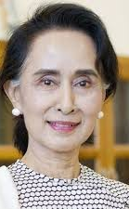
Aung San Suu Kyi​
"Freedom from Fear"
Inspired by Gandhi’s thoughts of non-violence
Remained under house arrest in Myanmar Separated from family
"She said “For me real freedom ¡s freedom from fear and unless you can leave free from freedom, you cannot live a dignified human life “

Slide 6


How many years Mandela spent in jail? a. 30 b. 29 c. 28 d. 27

Slide 7
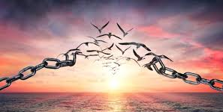
So from these books we can see the power of ideals of Freedom.
This ideal was at the center of our National struggle and the struggles of people of Asia, Africa against the British, French and the Portuguese colonialism.

Slide 8
'Long Walk to Freedom' is an autobiography of which famous person?
a. Mahatma Gandhi
b. Karl Marx
c. Nelson Mandela
d. Aung San Suu Kyi

Slide 9

What Is Freedom?
Definition says” An individual could be considered free if he/she is not subject to external control and is able to make independent decisions and act in independent way”
"Absence Of Constraints"
But Absence of constraint is one dimension
Freedom is about expanding the ability of the people to freely express themselves and develop their potential.
i.e., Creativity and capabilities are developed

Slide 10
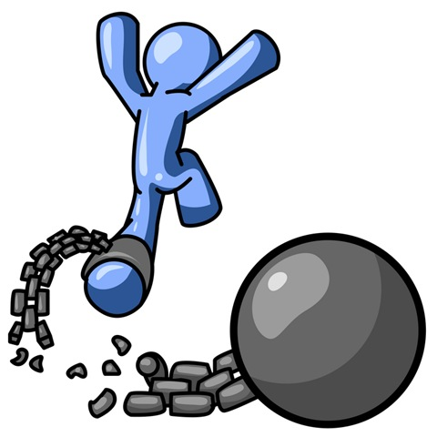
A free society ¡s which enables all its members to develop their potential with “minimum of social constraints”
‘ But an individual cannot expect that there should be no restriction, hence it becomes important for us to understand “Which constraints are acceptable, and Which are not”

Slide 11
Sources of Constraints
Therefore, some form of a Government is required, if it is a democratic form of a Government then, the members of a State can retain some control over their rulers. Democratic government is an important means of protecting the Freedom of the people
Constraints can also occur due to social and economic inequality which is existing in the society
Freedom is restricted either by Domination or External controls, such restrictions may be imposed through force or by law

Slide 12

Freedom means absence of constraints.
True/False

Slide 13
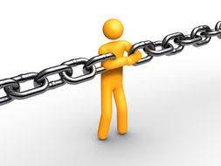
Why do we need constraints?
Constraints are essential to enjoy freedom.
To develop respect for views and beliefs of others.
It is necessary for the creation of a society.
Absence of constraint would lead to imposition of beliefs and ideas of stronger groups eventually leading to conflict.
Constraints are required to control violence and settle disputes.
Differences may exist between people regarding their ideas and opinions, they may have conflicting ambitions.

Slide 14
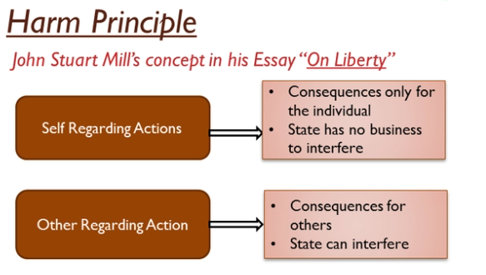
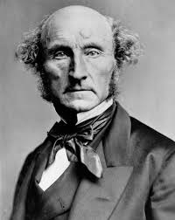
HARM PRINCIPLES

Slide 15
He says only ¡n special cases Freedom can be constrained because Freedom is crucial for leading a dignified human life Special cases as in
Harm caused must be serious
For minor harm Mill recommends only social disapproval
People should tolerate different ways of life, different points of view and different interest if they are not causing harm to others, in order to maintain the spirit of protecting Freedom
• But such tolerance need not be extended to views and actions which may put people ¡n danger or foment hatred against them.
In the constitutional discussions in India, the term used for such justifiable constraints is ‘reasonable restrictions.

Slide 16
Harm Principle was introduced by...
a. J S Mill
b. Mahatma Gandhi
c. Karl Marx
d. Nelson Mandela

Slide 17
To whom does Swaraj concept belong?
a. Gandhi
b. Nelson Mandela
c. Leo Tolstoy
d. Ruskin Bond

Slide 18
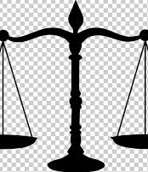
Negative and Positive Liberty

Slide 19
Difference Between Negative & Positive Liberty
S.No | Negative Liberty | Positive liberty
1 | Defines and defends the area of an individual’s life where no external authority can interfere. | Defines the area of society where an individual can be free with some constraints made by the society and the government.
2 | Not concerned with the conditions of the society. | Concerned with the enabling conditions of the society.

Slide 20
3 | Concerned with explaining the idea of ‘freedom from’. | Concerned with explaining the idea of ‘freedom to’.
4 | Area comes into personal domain of the individual. | Area comes into social domain of the individual.
5 | More negative liberty leads to more freedom. | More positive liberty checks excess of freedom to an individual, which could be an obstruction for social stability.

Slide 21
Negative Liberty defines the personal area of an individual, there is no external authority.
True/ False

Slide 22

Freedom of Expression(F0E)
FOE means the freedom to express one’s views through speech, writing etc.
It is considered to belong to the minimum area of ‘non-interference’, that is, negative liberty.
According to the provisions of the Indian Constitution, this is a fundamental right.
Society cannot restrict people from expressing themselves freely whether it agrees with their views or not.

Slide 23

A reasonable restriction of FOE is one that allows society to function smoothly and curbs interference in privacy.
These restrictions are reasonable as they are necessary to run the society smoothly.
Following are some reasonable restrictions on freedom of speech.
Freedom of speech cannot interfere in someone’s privacy. Employees of Royal household of England are constrained by contract from disclosing any inner affairs of the royal household.
Another example of putting restriction on freedom of speech is of film censor board. Censor board of films ban some portion of film to prevent adverse effect on society or disturbance of peace.

Slide 24
J.S.MiII view
In his book On Liberty, he offers 4 reasons as to why there should be Freedom of Expression even for those who believe ideas that appear ‘false’ or misleading today.
I. No idea is completely false.
2. Truth does not emerge by itself.
3. This conflict of ideas is valuable not just in the past but is of continuing value for all times.
4. We cannot be sure that what we consider true is actually true.

Slide 25
Banning of books, movies, plays, academic articles etc is explotation of Positive Liberty.
True/False

Slide 26

Recapitulation
The ideals of Freedom
What is Freedom?
Sources of Constraints
Why do we need constraints ?
Harm Principles
Negative and Positive Liberty
Freedom of Expression(F0E)
J.S.MiII view

