Slide 1
RELATION
&
FUNCTIONS

Slide 2
ORDERED PAIR
Ordered pair is a pair of objects or elements taken in a specific order.
In ordered pair (a,b) ‘a’ is called the first element (or component) and ‘b’ is called the second element(or component).
Two ordered pair (a,b) and (c,d) are equal,iff a=c and b=d

Slide 3
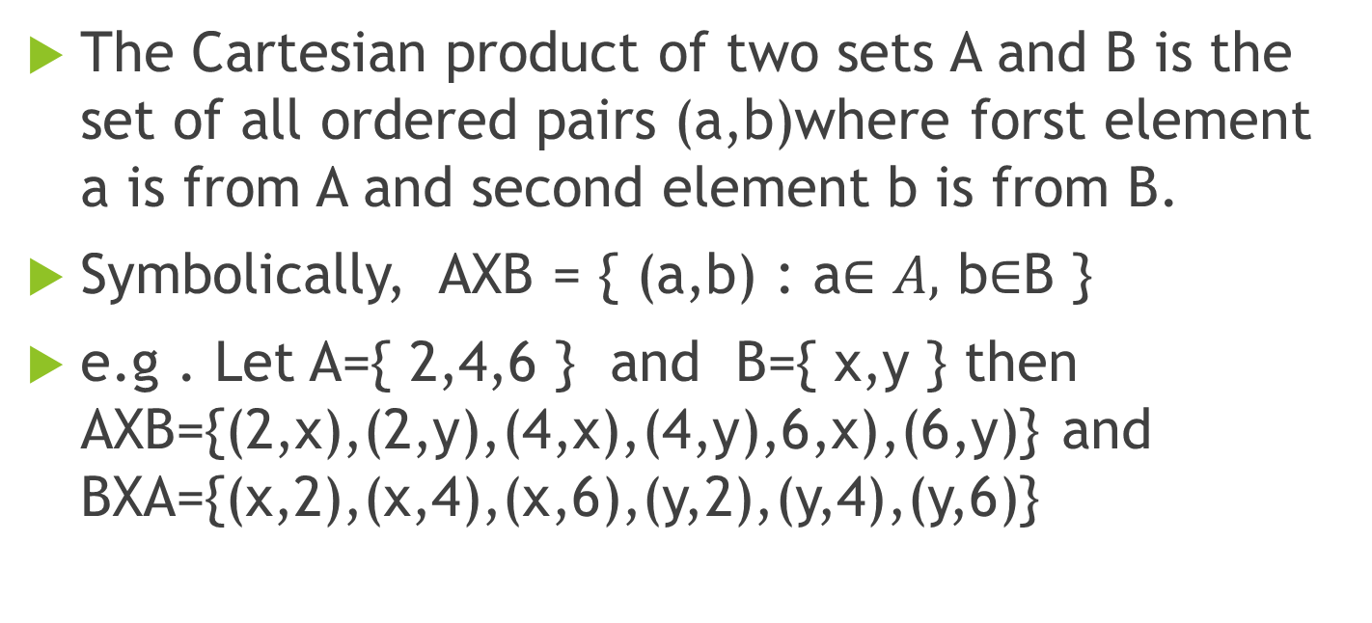
CARTESIAN PRODUCT OF TWO SETS
The Cartesian product of two sets A and B is the set of all ordered pairs (a,b)where forst element a is from A and second element b is from B.
Symbolically, AXB = { (a,b) : a$∈A,$ b$∈$B }
e.g . Let A={ 2,4,6 } and B={ x,y } then AXB={(2,x),(2,y),(4,x),(4,y),6,x),(6,y)} and BXA={(x,2),(x,4),(x,6),(y,2),(y,4),(y,6)}

Slide 4
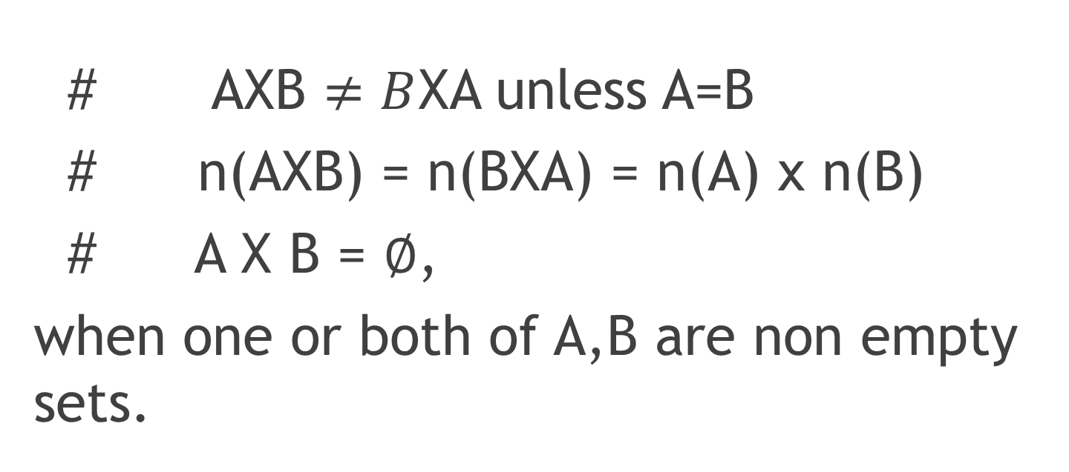
OBSERVATIONS:
# AXB $≠B$XA unless A=B
# n(AXB) = n(BXA) = n(A) x n(B)
# A X B = $∅$,
when one or both of A,B are non empty sets.

Slide 5
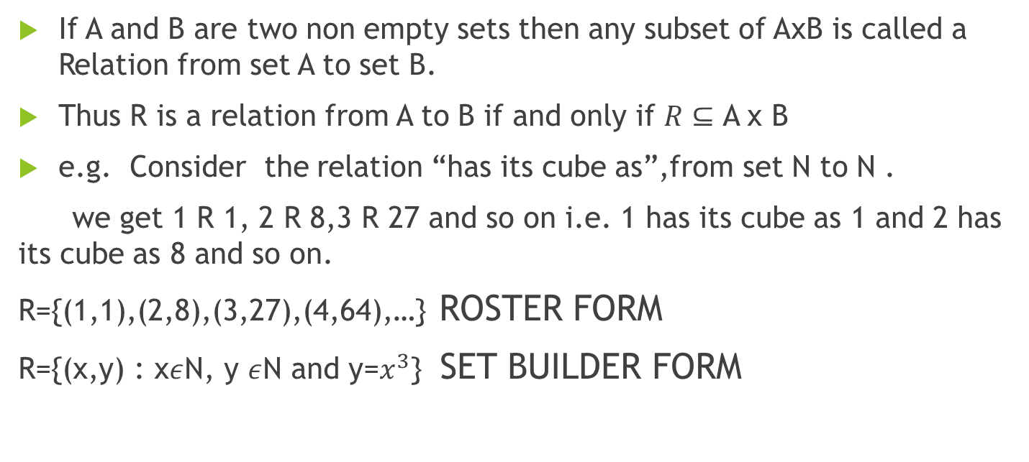
RELATION
If A and B are two non empty sets then any subset of AxB is called a Relation from set A to set B.
Thus R is a relation from A to B if and only if $R⊆$ A x B
e.g. Consider the relation “has its cube as”,from set N to N .
we get 1 R 1, 2 R 8,3 R 27 and so on i.e. 1 has its cube as 1 and 2 has its cube as 8 and so on.
R={(1,1),(2,8),(3,27),(4,64),…} ROSTER FORM
R={(x,y) : x$ε$N, y $ε$N and y=$x^{3}$} SET BUILDER FORM

Slide 6
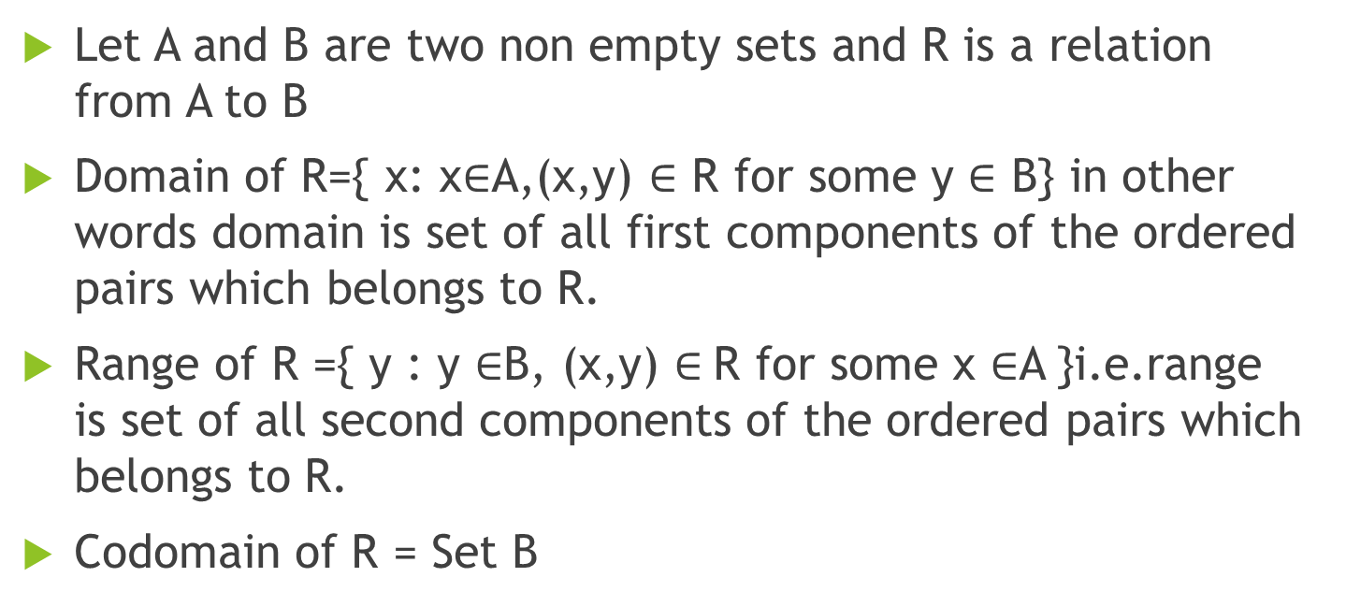
DOMAIN AND RANGE OF RELATION
Let A and B are two non empty sets and R is a relation from A to B
Domain of R={ x: x$∈$A,(x,y) $∈$ R for some y $∈$ B} in other words domain is set of all first components of the ordered pairs which belongs to R.
Range of R ={ y : y $∈$B, (x,y) $∈$R for some x $∈$A }i.e.range is set of all second components of the ordered pairs which belongs to R.
Codomain of R = Set B

Slide 7
EXAMPLE:
Let A={ 1,2,3,7,9 } , B={ 2,3,6,8 } and R={ (1,2),(2,3),(3,3),(7,6) }
Domain of R = {1,2,3,7}
Range of R = { 2,3,6}
Codomain of R = { 2,3,6,8 }

Slide 8
FUNCTIONS
A function is a special type of relation

Slide 9
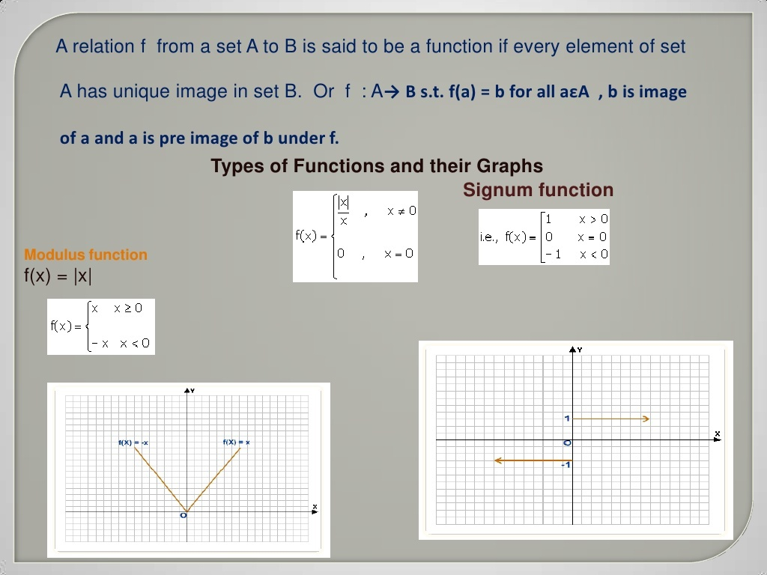

Slide 10
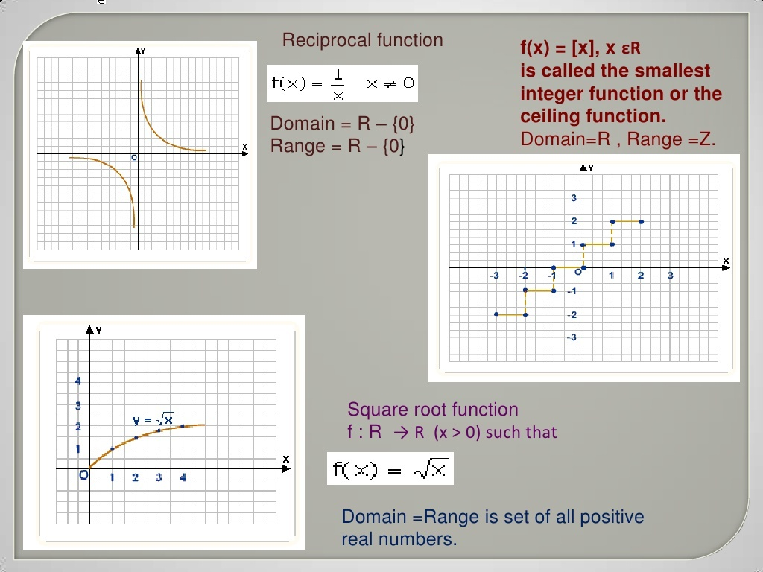

Slide 11
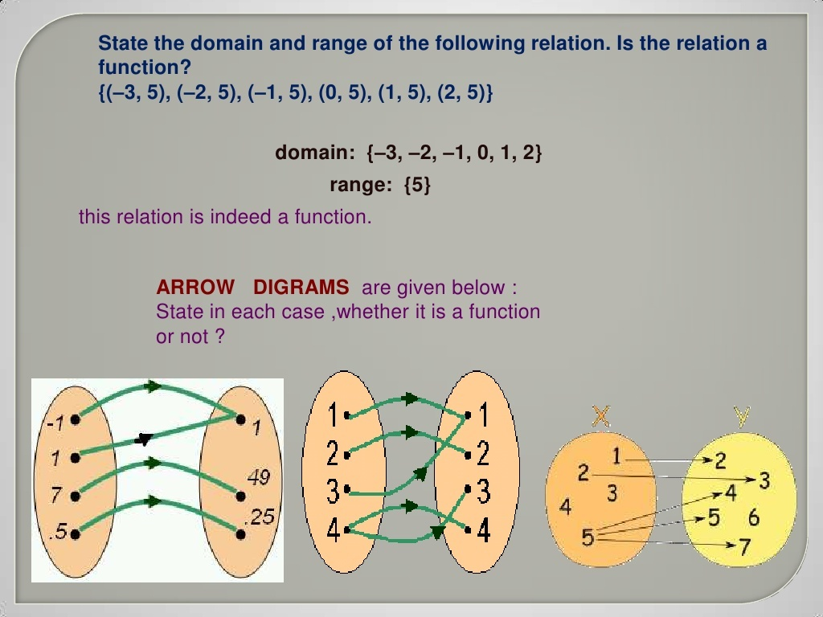

Slide 12
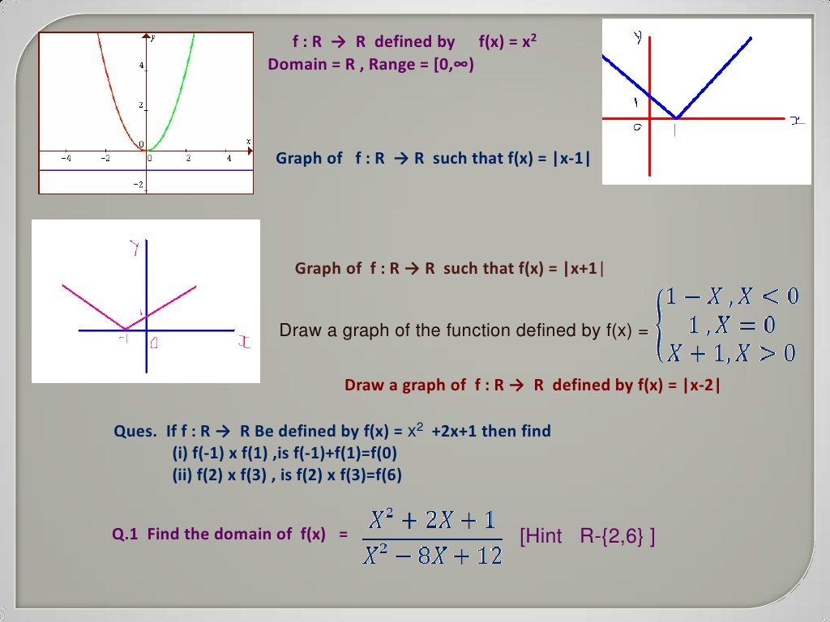

Slide 13
THANKS

