Slide 1
SETS

Slide 2
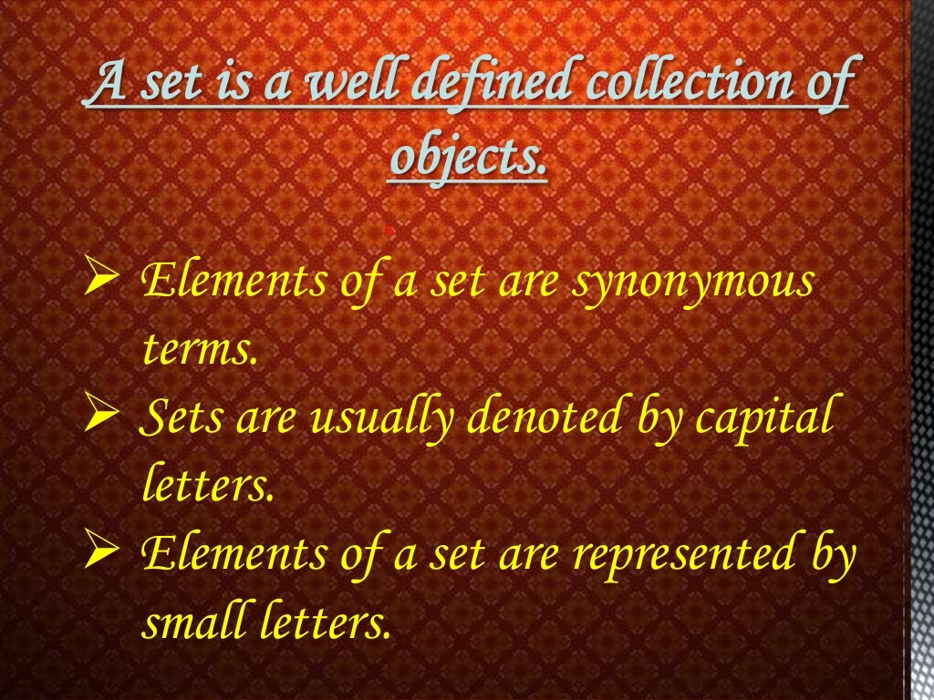

Slide 3
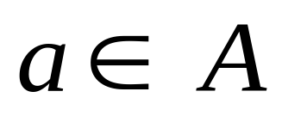
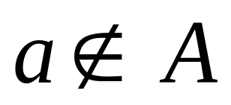
Let A be any set of objects and ‘ a’ be an element of A , then we write
and read it as ‘ a belongs to A’ or ‘ a is an element of A’
If a is not an element of A then

Slide 4
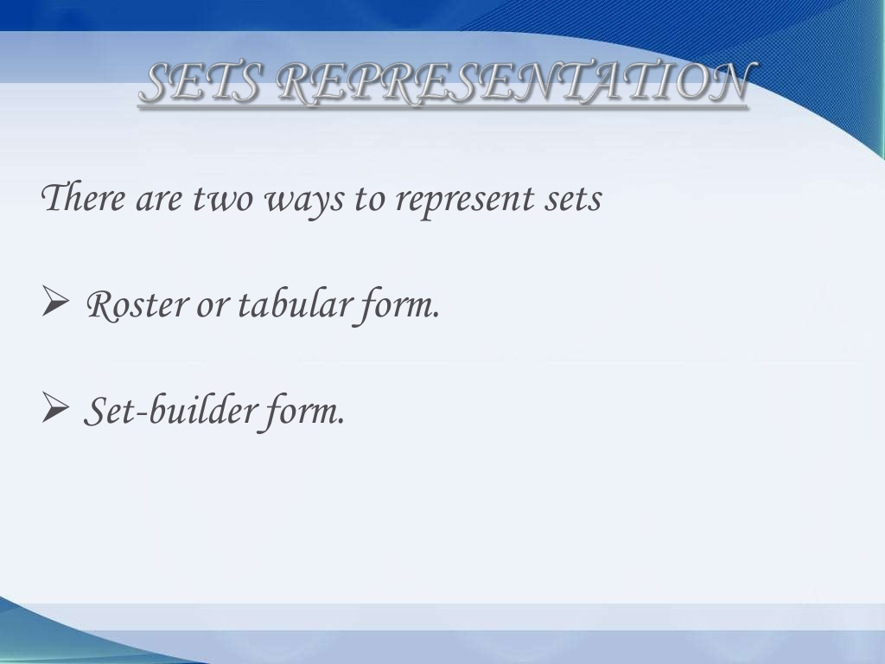

Slide 5
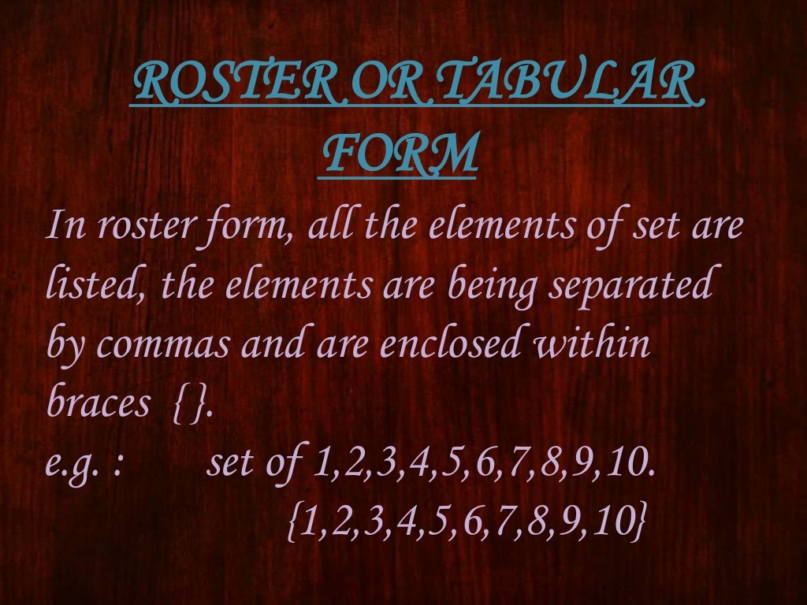

Slide 6
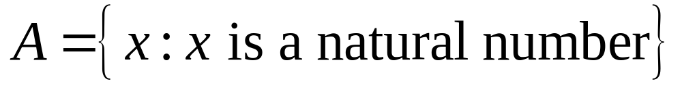
SET BUILDER FORM
In set builder form we write the set by some special property (or properties) satisfied by all its elements .
e.g.If A is set of natural numbers then we write it as

Slide 7
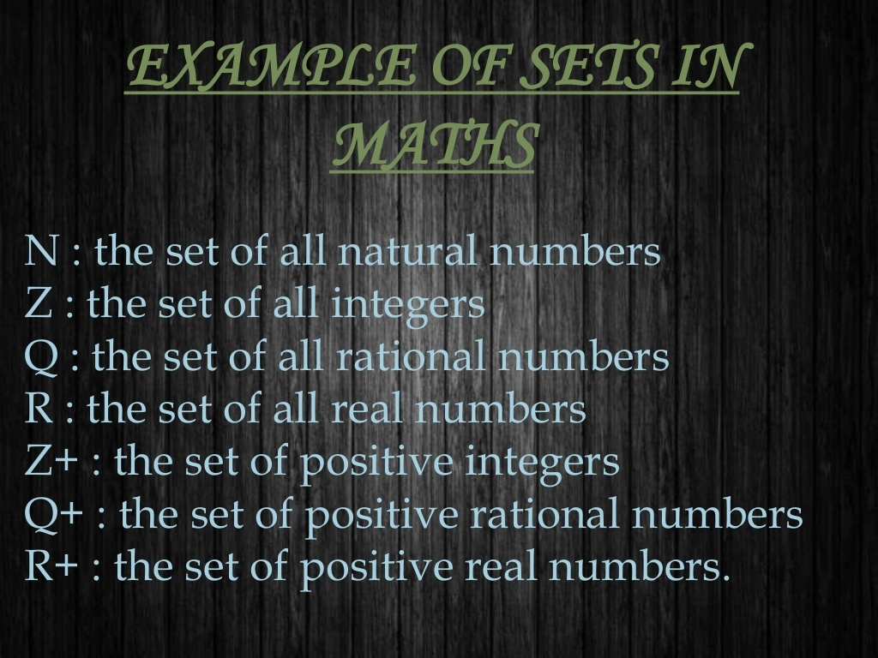

Slide 8
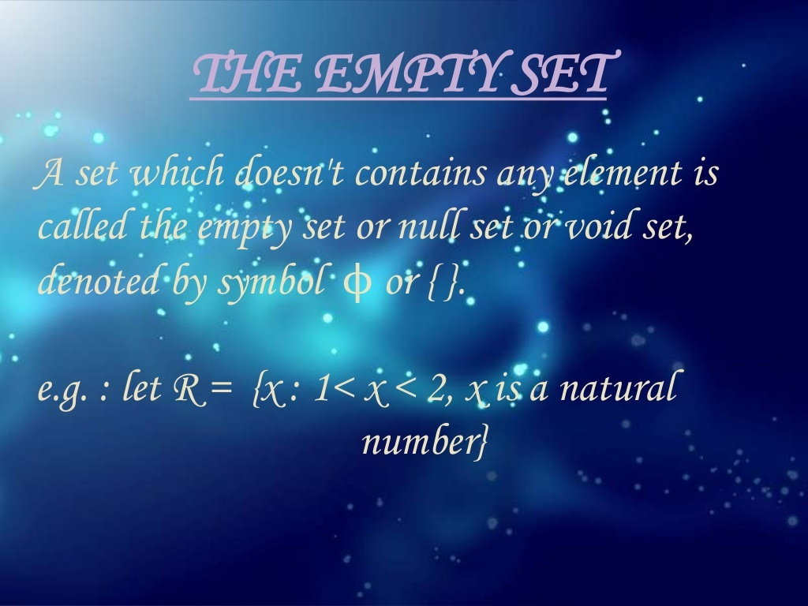

Slide 9
FINITE AND INFINITE SETS
If elements of a set are finite in number,then it is called Finite set and if number of elements are not finite (i.e.infinite) then it is called Infinite set.
e.g.Let A be the set of days of the week,then A is finite set.
Let B be the set of natural numbers,then B is infinite set.

Slide 10
EQUAL SETS
Two sets A and B are equal if every element of A is an element of B and every element of B is an element of A.
e.g. Let A = {1,2,3,4} , B={1,2,2,4,3}
Then A=B
Because every element of A is in B and every element of B is in A

Slide 11
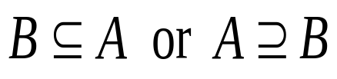
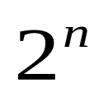
SUBSETS
The set B is said to be the subset of set A if every element of set B is also an element of A. Symbolically, we write it as ,
Read as ‘B is contained in A ’ or ‘B is subset of A ’
If a set has ‘n’ elements then number of subsets are :

Slide 12
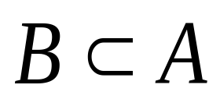
PROPER SUBSET
A set B is said to be proper subset of set A if every element of set B is an element of A whereas every element of A is not an element of B
Symbol :
Read as “B is proper subset of A”.

Slide 13
POWER SET
The collection of all subsets of a set A is called the power set of A. It is denoted by P(A)
e.g. if A = {1,2},then P(A) ={ Ø,{1},{2},{1,2} }

Slide 14
UNIVERSAL SET
When all sets under consideration are subsets of a larger set then this larger set is called the universal set,denoted by U .
e.g. when we are using intervals on real line ,then the set R of real numbers is taken as the universal set.

Slide 15
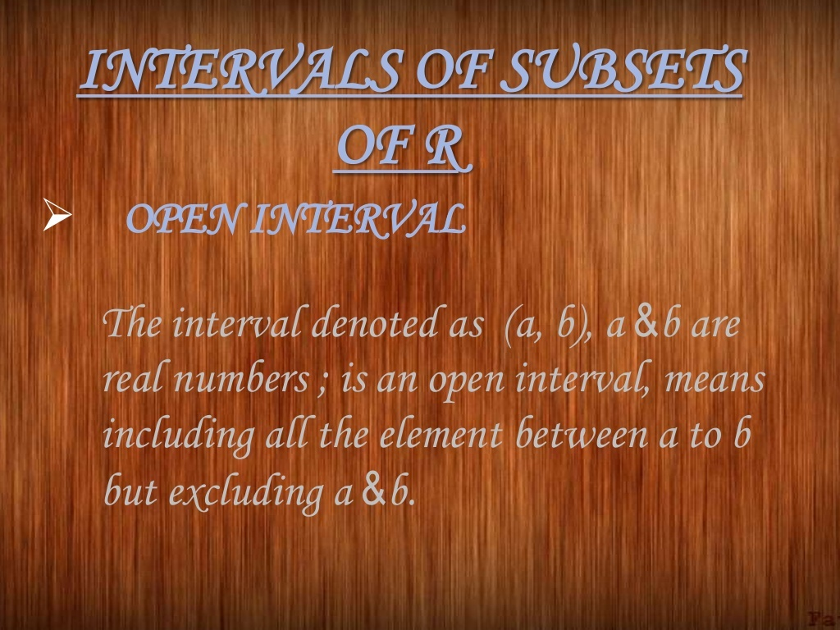

Slide 16
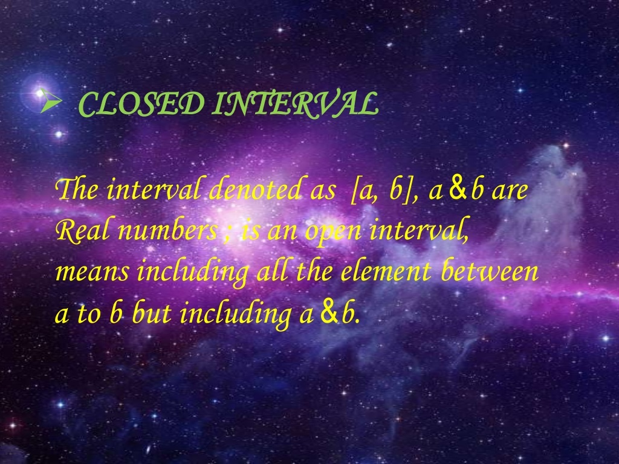

Slide 17
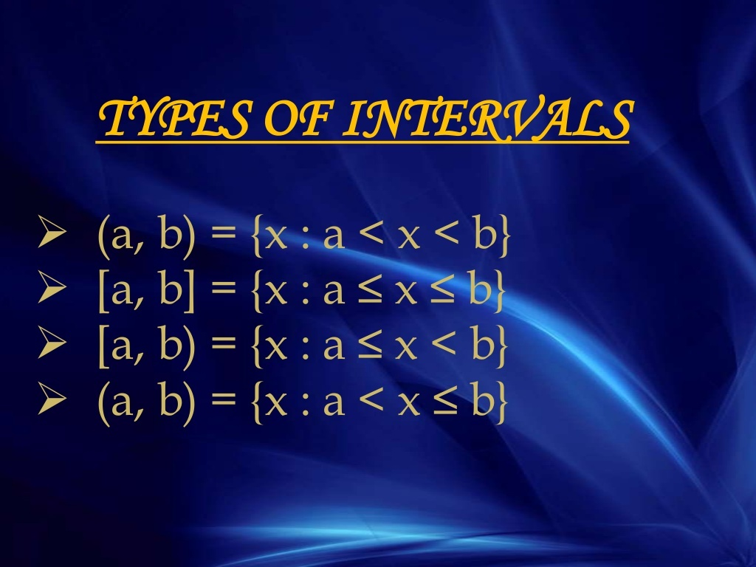

Slide 18
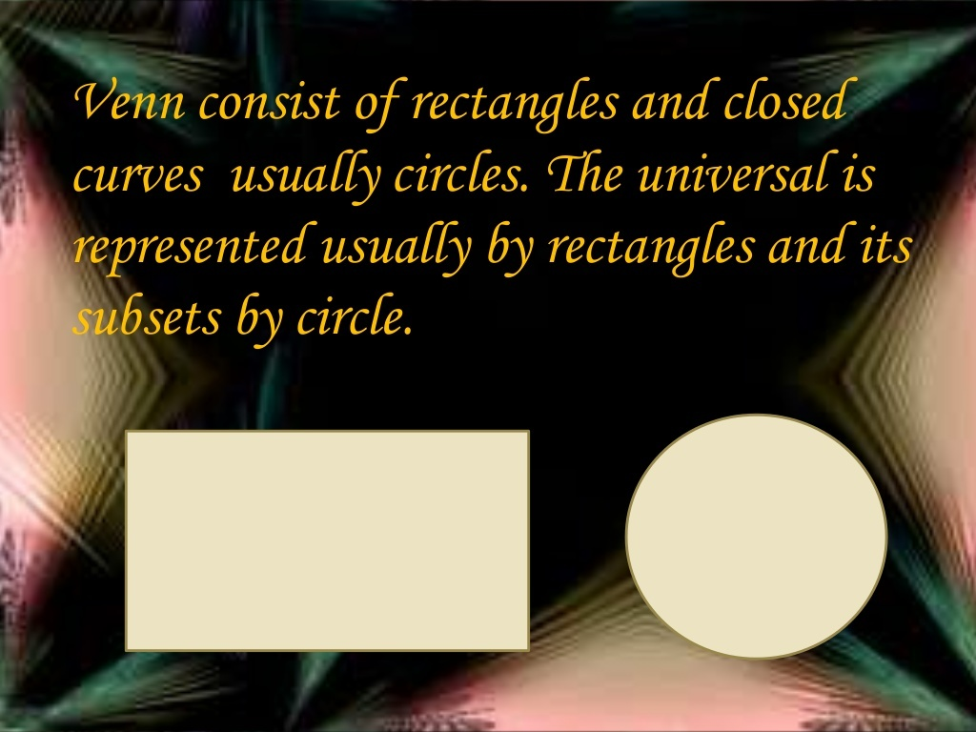

Slide 19
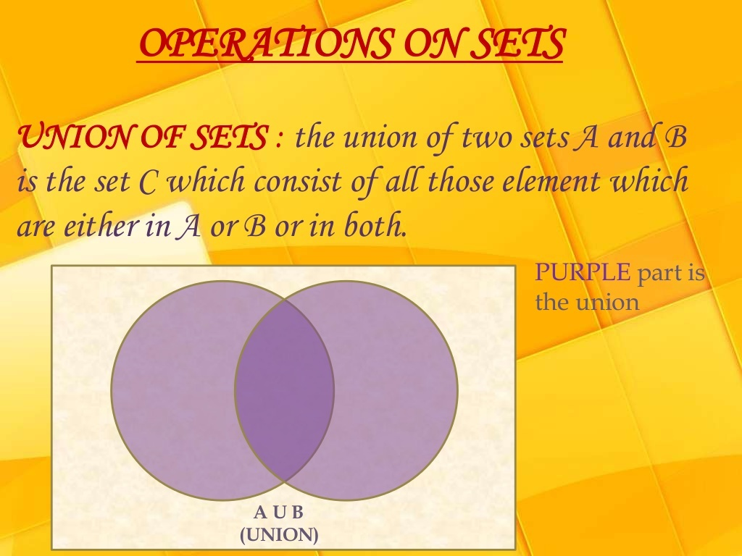

Slide 20
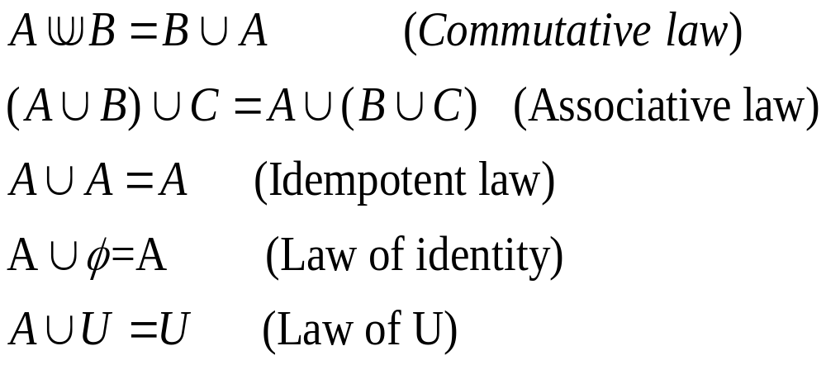
PROPERTIES OF UNION OF SETS

Slide 21

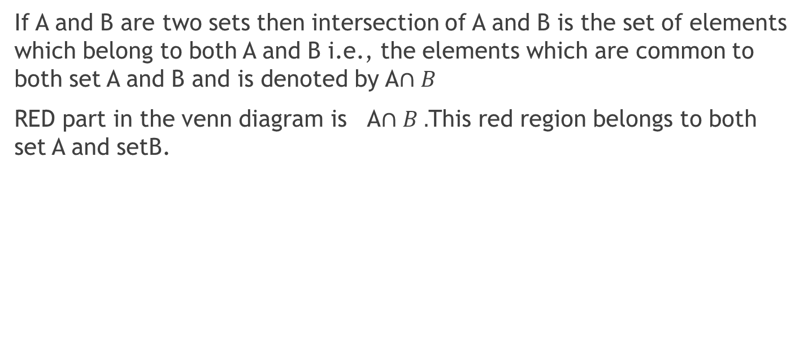
INTERSECTION OF SETS
If A and B are two sets then intersection of A and B is the set of elements which belong to both A and B i.e., the elements which are common to both set A and B and is denoted by A$∩B$
RED part in the venn diagram is A$∩B .$This red region belongs to both set A and setB.
A
$$U$$
A
B

Slide 22
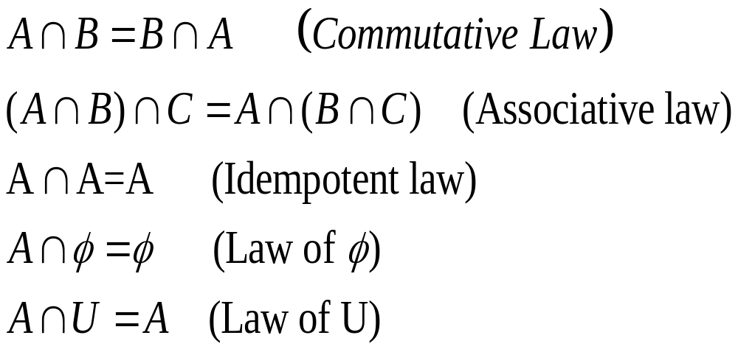
PROPERTIES OF INTERSECTION OF SETS

Slide 23
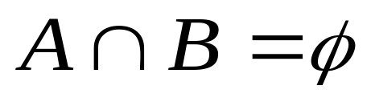
DISJOINT SETS
If A and Bare two sets such that there are no common elements in A and B then these are called Disjoint sets i.e.
e.g. A={a,b,c,d} and B=(e,f,g,h]

Slide 24
COMPLIMENT OF A SET
Compliment of a given set is a set which contains all those elements of the universal set that do not belong to the given set denoted by A’or Not A
e.g. U={a,b,c,d} and A={a,b,d} then A’={c}

Slide 25
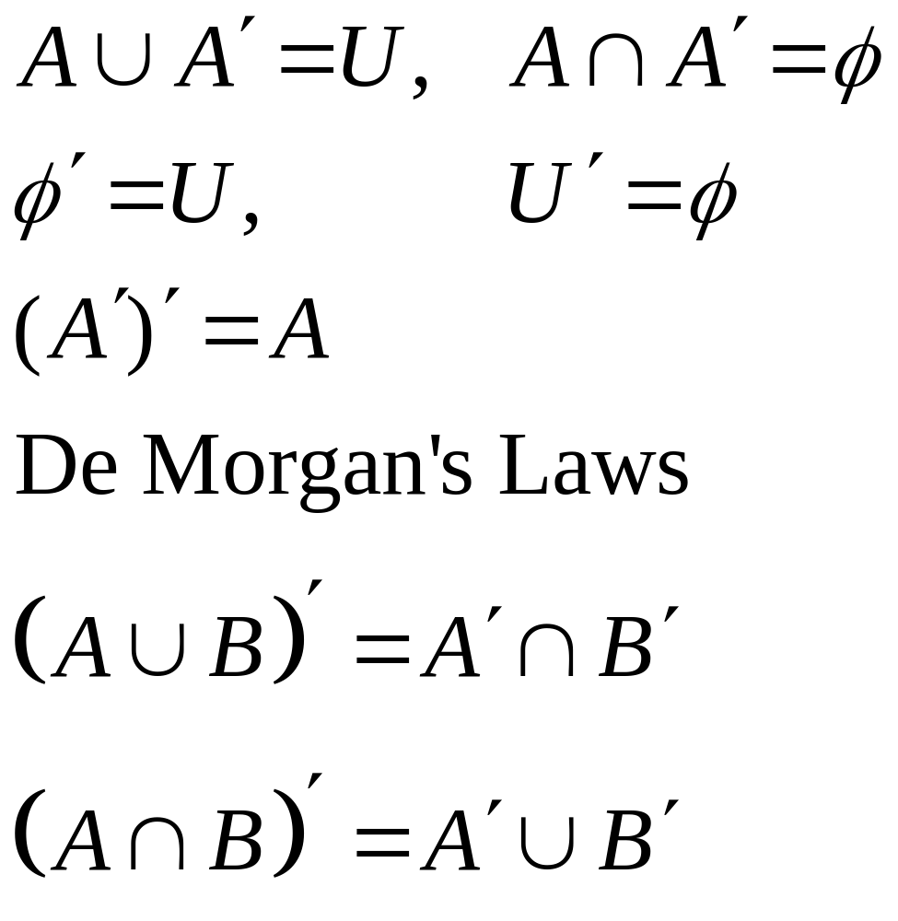
PROPERTIES OF COMPLIMENT OF A SET

Slide 26
THANKS

