Slide 1
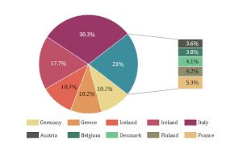
CLASS :XI
SUBJECT :ECONOMICS
AIR FORCE SCHOOL,AMBALA

Slide 2
CH -2 COLLECTION
OF
DATA

Slide 3
Sources of Data
There are two sources of data:
Primary Source of Data -It implies collection of data from its source of origin.
Secondary Source of Data- It implies collection of data from some agency or institution which already happens to have collected the data through statistical survey.

Slide 4
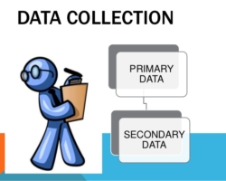
Types of data
There are two types of data:
Primary Data : These data are collected by the investigator for his own purpose for the first time, from beginning to end are called primary data.
Secondary Data: These data have already been collected by somebody else, these are available in the form of published or unpublished report.

Slide 5
Principal Differences between Primary and Secondary Data
Primary data are original and secondary data are already in existence and therefore, are not original.
Primary data do not need any adjustment, secondary data need to be adjustment to suit the objective of study in hand.
Primary data are expensive and secondary data are less expensive.

Slide 6
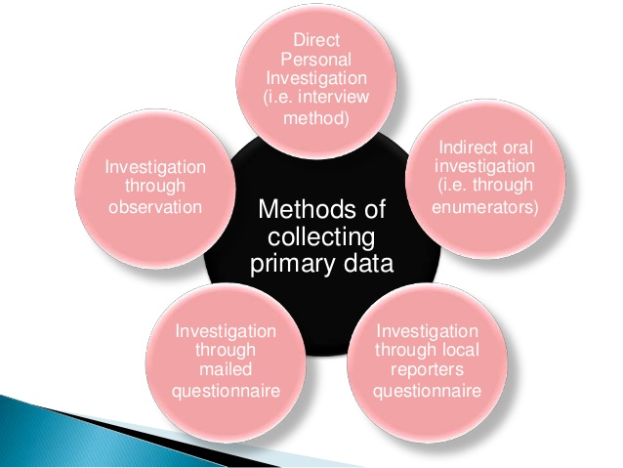
METHODS OF COLLECTING PRIMARY DATA

Slide 7
Direct Personal Investigation
It is the method by which data are personally collected by the investigator from the information. Merits and demerits of this method are follows.
(a) Merits
Originality
Reliability
Uniformity
Accuracy
Related information
Elastic
(b) Demerits
Difficult to cover wide areas
Costly
Personal bias
Limited coverage

Slide 8
(ii) Indirect Oral Investigation
It is the method by which information is obtained not from the persons regarding whom the information is needed. It is collected orally from other persons who are expected to possess the necessary information.
Merits
Expert opinion
Simple
Less expensive
Wide coverage
Free from bias
Demerits
Less accurate
Doubtful conclusions
Biased

Slide 9
(iii) Information from Local Sources or Correspondents
Under this method, the investigator appoints local persons or correspondents at different places. Merits and demerits of this method are given below
(a) Merits
Economical
Wide coverage
Continuity
Suitable for special purpose
(b) Demerits
Loss of originality
Lack of uniformity
Personal bias
Less accurate
Delay in collection

Slide 10
(iv) Information Through Questionnaries and Schedules
There are two ways of collecting information on the basis of questionnaire
(a) Mailing Method Under this method questionnaires are mailed to the
informants. The method is most suited when
The area of the study is very wide.
The informants are educated.
(b) Enumerator’s Methods Under this Method enumerator himself fills
the schedules after seeking information from the informants. This
method is mostly used when
field of investigation is large.
the investigation need specialised and skilled investigation.
the investigators are well versed in the local language and cultural
norms of the informants.

Slide 11
(c) Collection of Secondary Data
There are two main sources of secondary data
Published sources
Unpublished sources(d) Published Sources
Some of the published source of secondary data are
Government publication
Semi-government publication
Reports of committees and commissions
Publications of trade associations
Publication of research institutions
Journals and papers
Publication of research scholars
International publication

Slide 12
(e) Unpublished Sources
These data are collected by the government organisations and others, generally for their self use or office record.
In order to assess the reliability, suitability and adequacy of the data, the following points must be kept in mind
Ability of the collecting organisation
Objective and scope
Method of collection
Time and condition of organisation
Definition of the unit
Accuracy

Slide 13

https://www.learncbse.in/statistics
https://mycbseguide.com/

