Slide 1
AIR FORCE SCHOOL ,AMBALA
CLASS : XI
SUBJECT :BUSINESS STUDIES
CHAPTER : BUSINESS,TRADE AND COMMERCE
PREPARED BY : MONIKA GOEL

Slide 2
CLASS :XI SUB:BUSINESS STUDIES
CHAPTER 1: BUSINESS ,TRADE AND COMMERCE
INTRODUCTION TO BUSINESS:
Business is not merely an activity to earn income or profit. Value of business is more than just a profit making activity. Business activities led to growth and development of any country.
Is it possible to think a week without business firms?
It is closely connected with our life. They satisfy our needs and wants by providing various types of goods and services. The purpose of business is to earn profit through customer satisfaction.

Slide 3
HISTORY OF TRADE AND COMMERCE :
Trade and commerce have played a vital role in making India to evolve as a major player in the economic world in ancient times as well as in times today.
Archaeological evidences have shown that trade and commerce was the basis of the economy of ancient India.

Slide 4
1.Indigenous Banking System
As economic life progressed, money served as a medium of exchange, the introduction of metallic money and its use accelerated economic activities.
Documents such as Hundi and Chitti were in use for carrying out transactions in which money passed from hand to hand.
Hundi as an instrument of exchange, which was famous in the subcontinent. It involved a contract which —
(i) warrant the payment of money, the promise or order which is unconditional
(ii) capable of change through transfer by valid negotiation.

Slide 5
NATURE AND CONCEPT OF BUSINESS
Human wants are unlimited. In every society people undertake various activities to satisfy their needs. Human activities can be classified into two:- (1) Economic Activities (2) Non Economic Activities
Economic Activities-Economic activities are those activities which are undertaken by people to earn money. Eg : A manager works in an office
Non Economic Activities- Non economic activities are those activities which are undertaken by people to get psychological satisfaction or as a hobby. Eg : House wife cooks food for her family,Gardening as a hobby, Playing football etc.

Slide 6
Differences Between Economic Activities and Non-economic Activities
ECONOMIC Activities and Non-economic Activities
Economic Activities
Undertaken by people to earn money
Its benefit can be measured in terms of money
Money is the reward
Non-economic Activities
Undertaken by people to get mental satisfaction
Its benefit can’t be measured in terms of money
Mental satisfaction is the reward

Slide 7
Examples:
Economic activities
A worker works in a factory
A doctor runs his clinic
A teacher works in a School
A manager works in an office
A business man runs a shop
Non Economic Activities
House wife cooks food for her family.
Boy helps an old man to cross the road.
Gardening as a hobby.
A mother looks after her children Playing football.
A patriot sacrifices his life for his motherland.

Slide 8
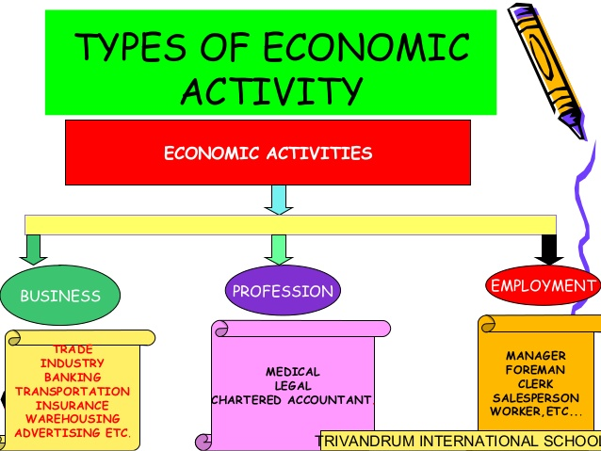

Slide 9
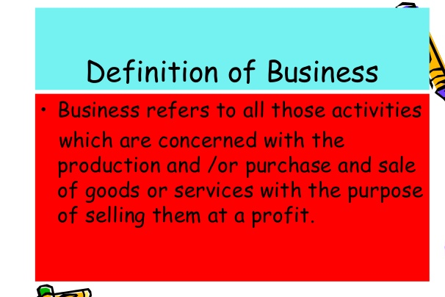

Slide 10
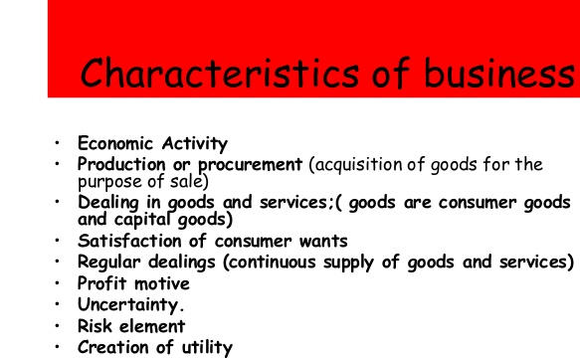

Slide 11
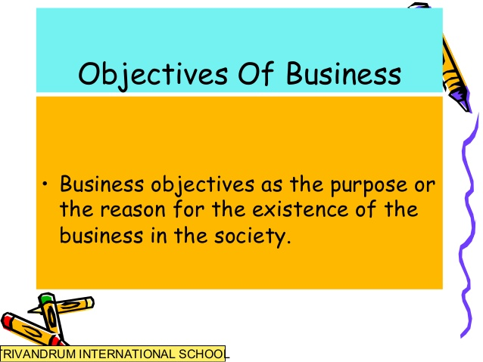

Slide 12
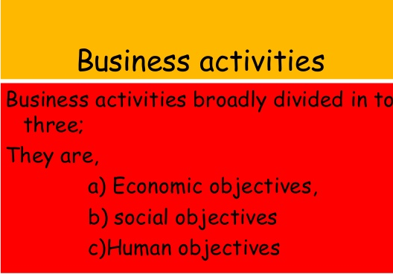

Slide 13
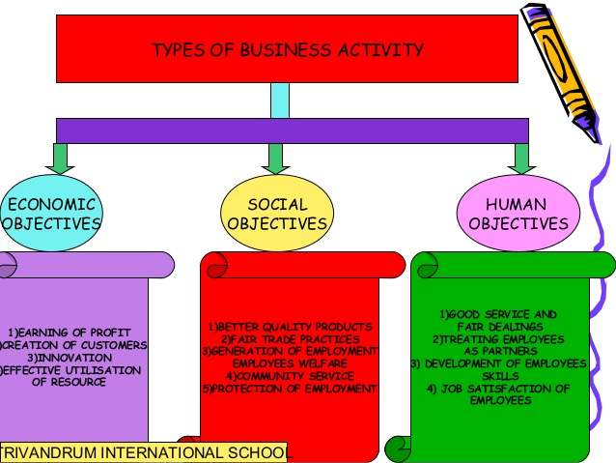

Slide 14


Slide 15
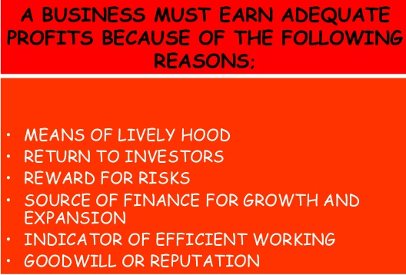

Slide 16
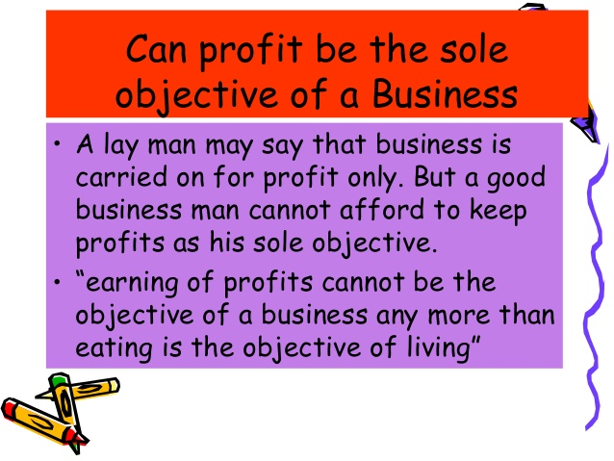

Slide 17
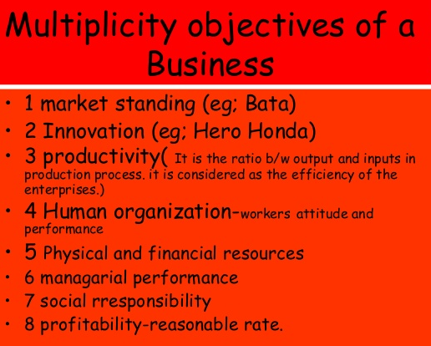

Slide 18
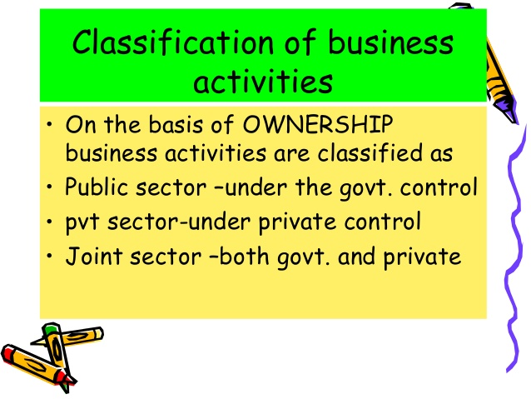

Slide 19
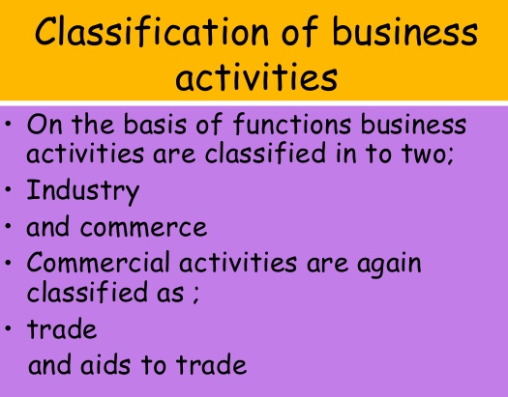

Slide 20
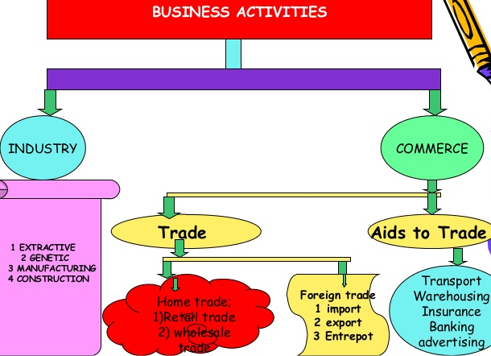

Slide 21
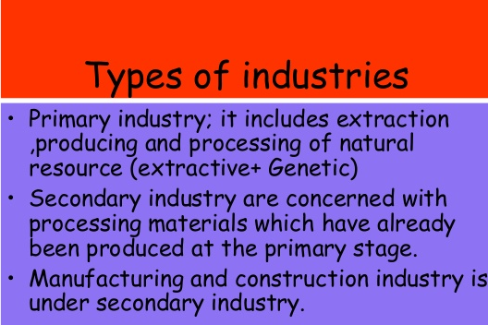

Slide 22
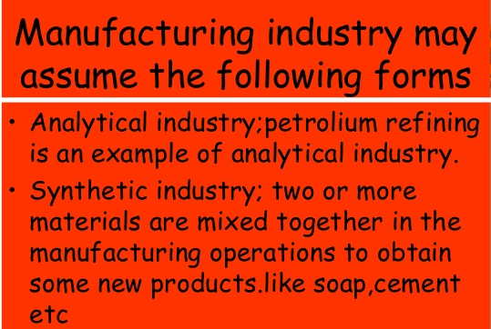

Slide 23
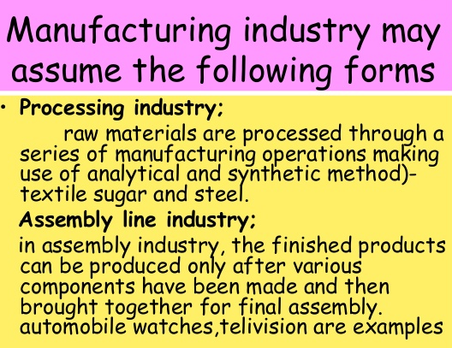

Slide 24


Slide 25


Slide 26
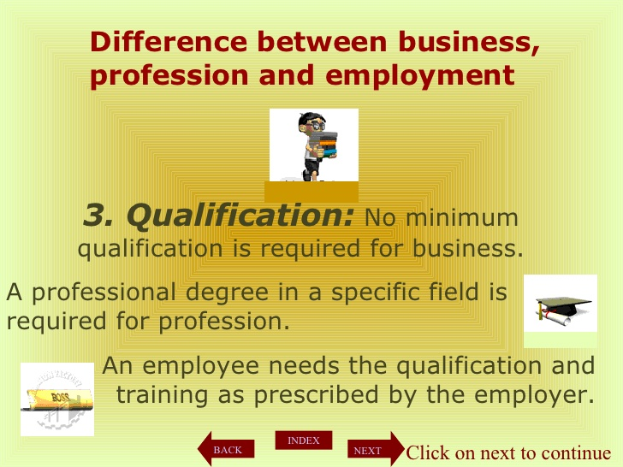

Slide 27


Slide 28
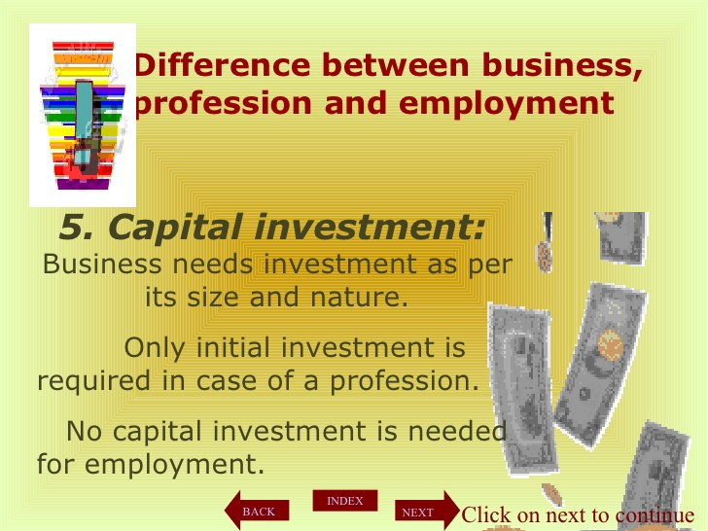

Slide 29
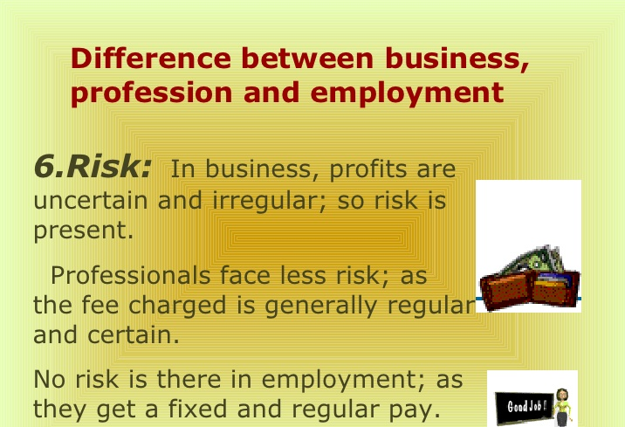

Slide 30
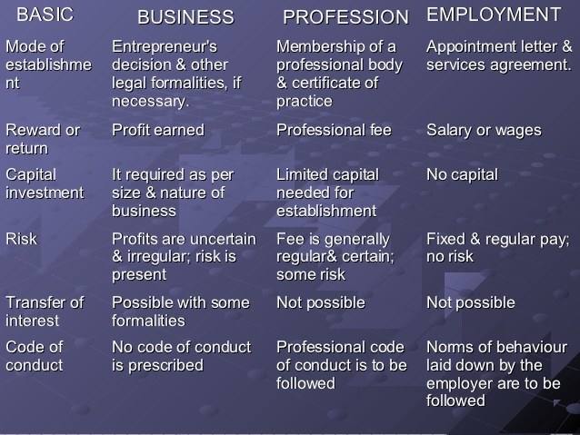

Slide 31
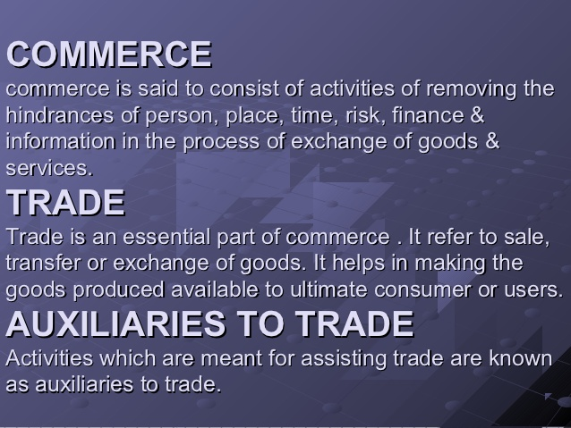

Slide 32
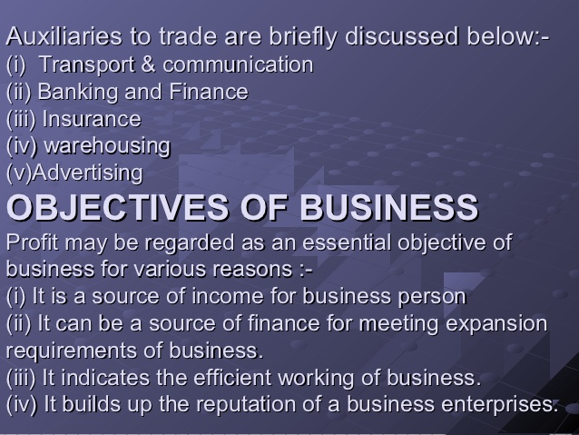

Slide 33
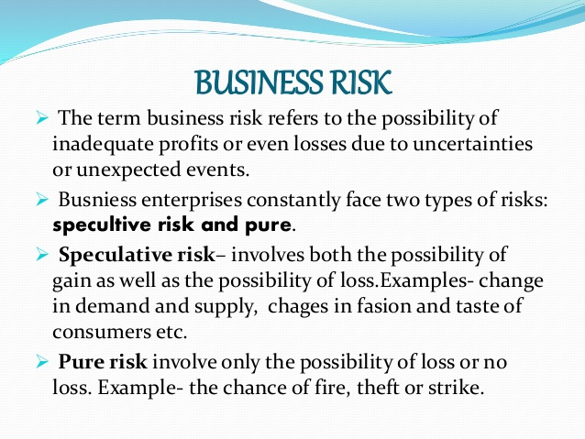

Slide 34
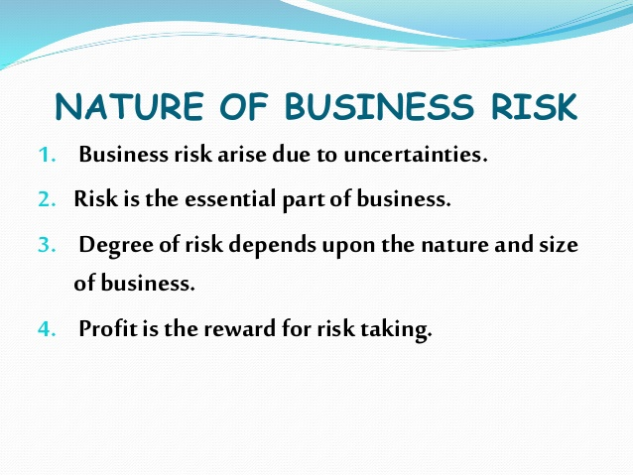

Slide 35
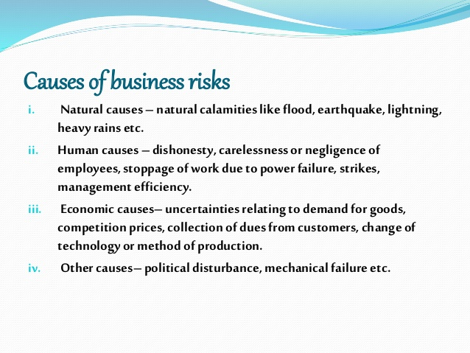

Slide 36
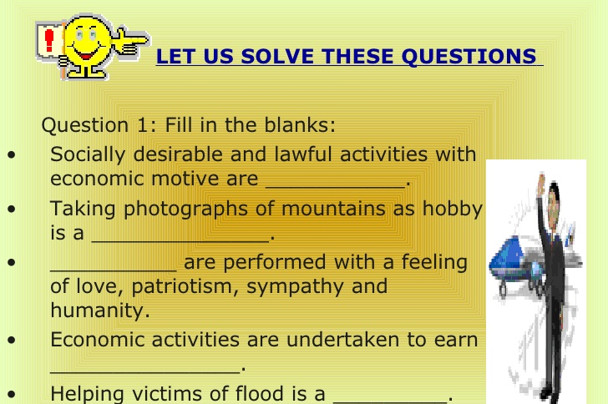

Slide 37
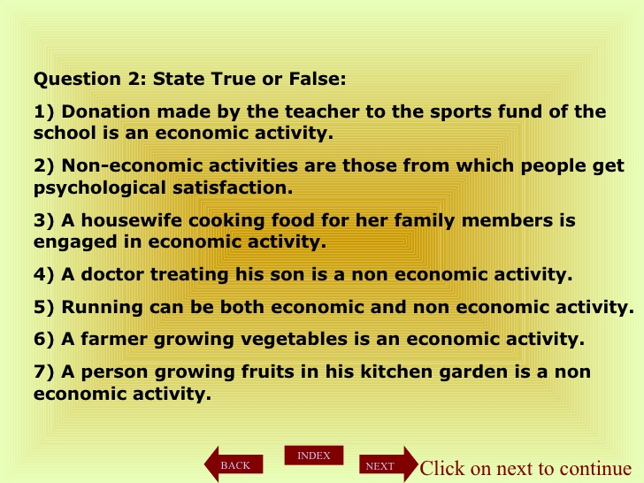

Slide 38
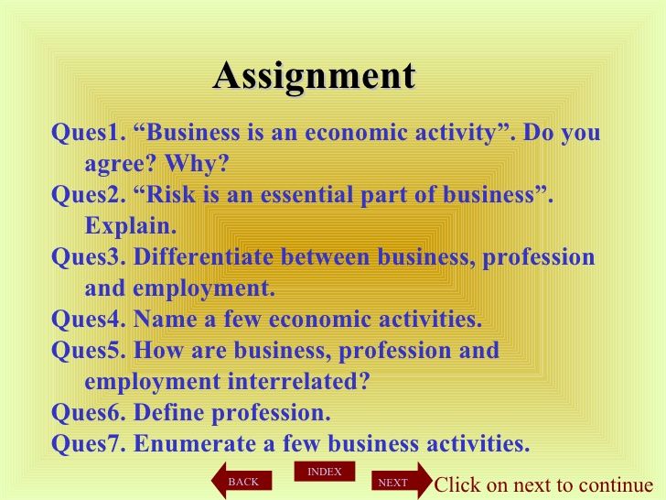

Slide 39
BIBLIOGRAPHY
Wikipedia.com
Slideshare.net
Yahoo.com
NcertBOOKS.GURU

